Slide 1
Chapter 20 Generic Classes and Methods: A Deeper Look
Java How to Program, 11/e
Questions? E-mail paul.deitel@deitel.com

Slide 2
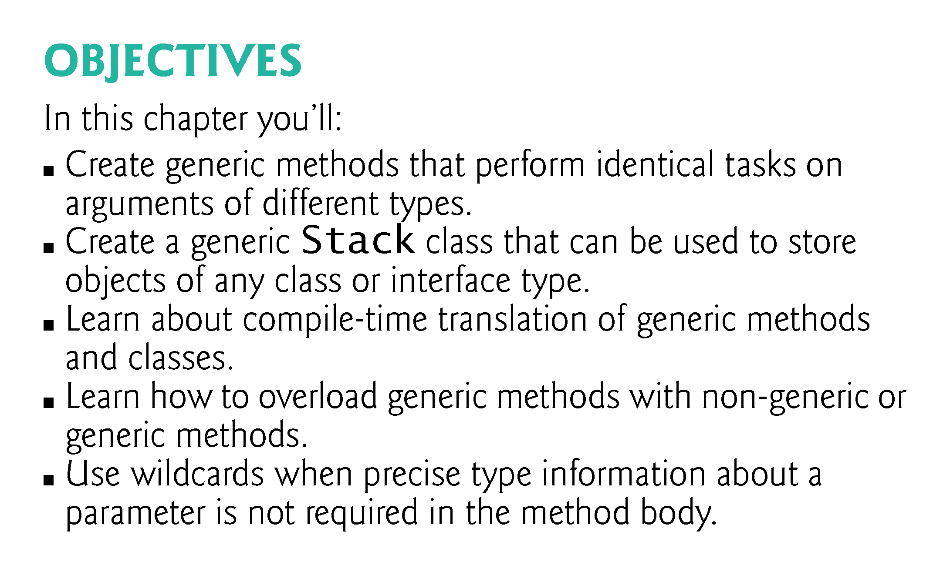

Slide 3
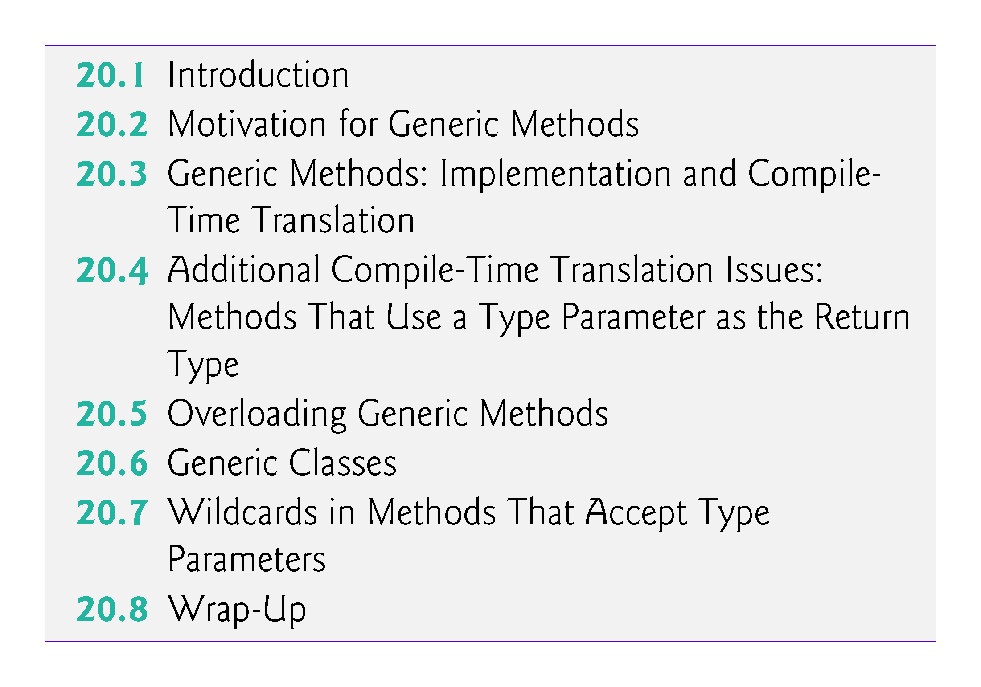

Slide 4
20.1 Introduction
Detect type mismatches at compile time—known as compile-time type safety.
Generic methods and generic classes provide the means to create type safe general models.

Slide 5
20.2 Motivation for Generic Methods
Overloaded methods are often used to perform similar operations on different types of data.
Study each printArray method.
Note that the type array element type appears in each method’s header and for-statement header.
If we were to replace the element types in each method with a generic name—T by convention—then all three methods would look like the one in Fig. 20.2.

Slide 6
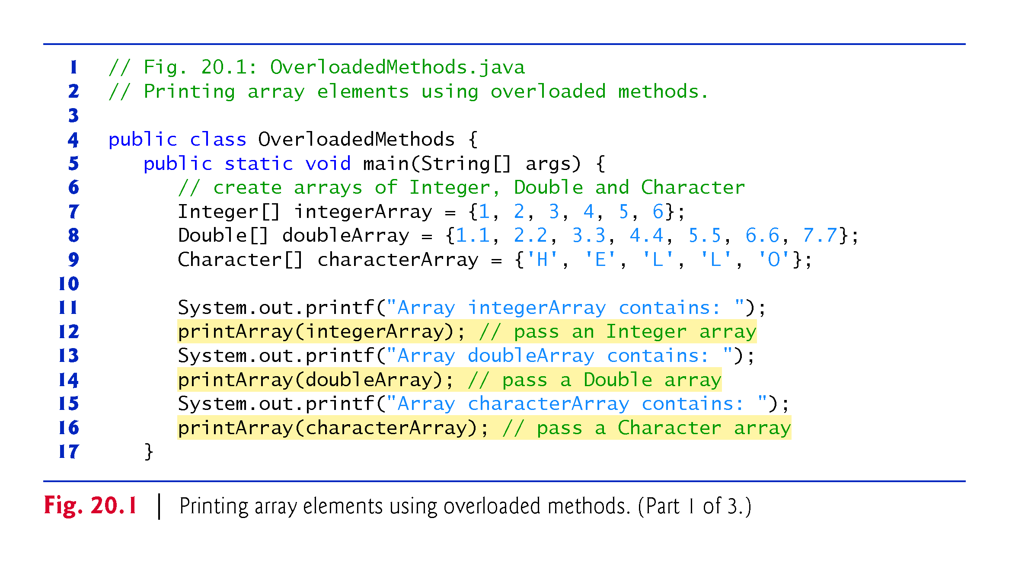

Slide 7
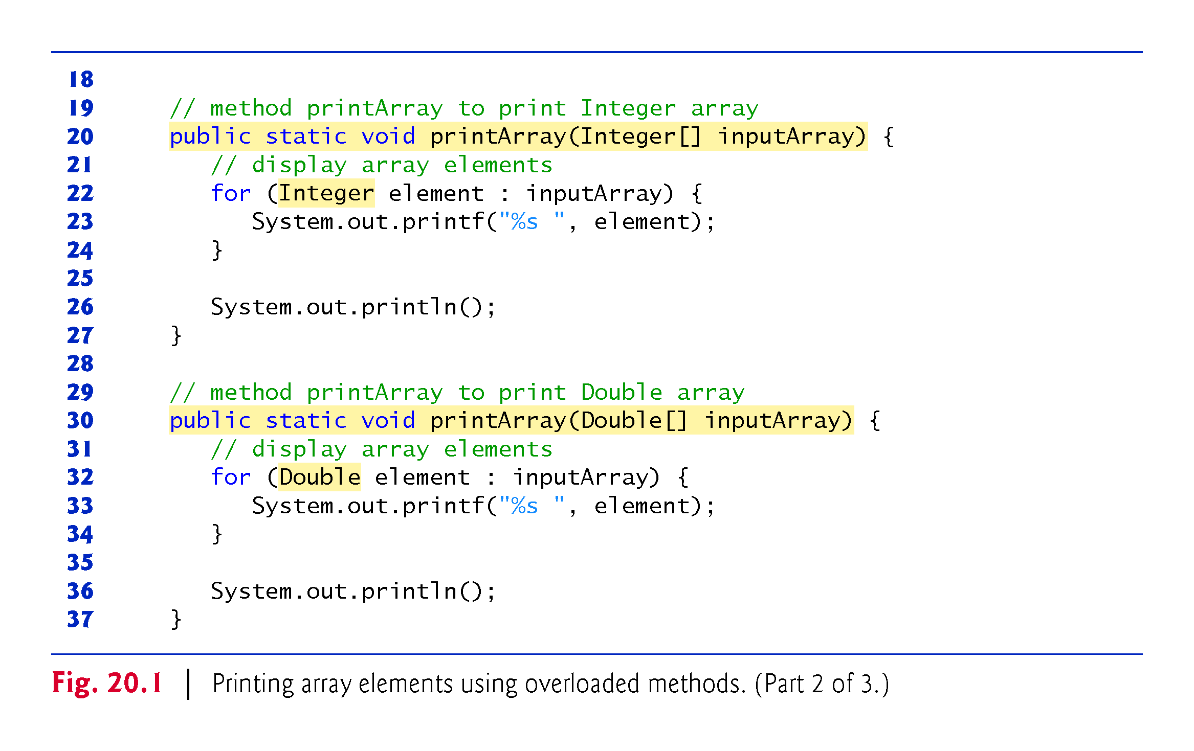

Slide 8
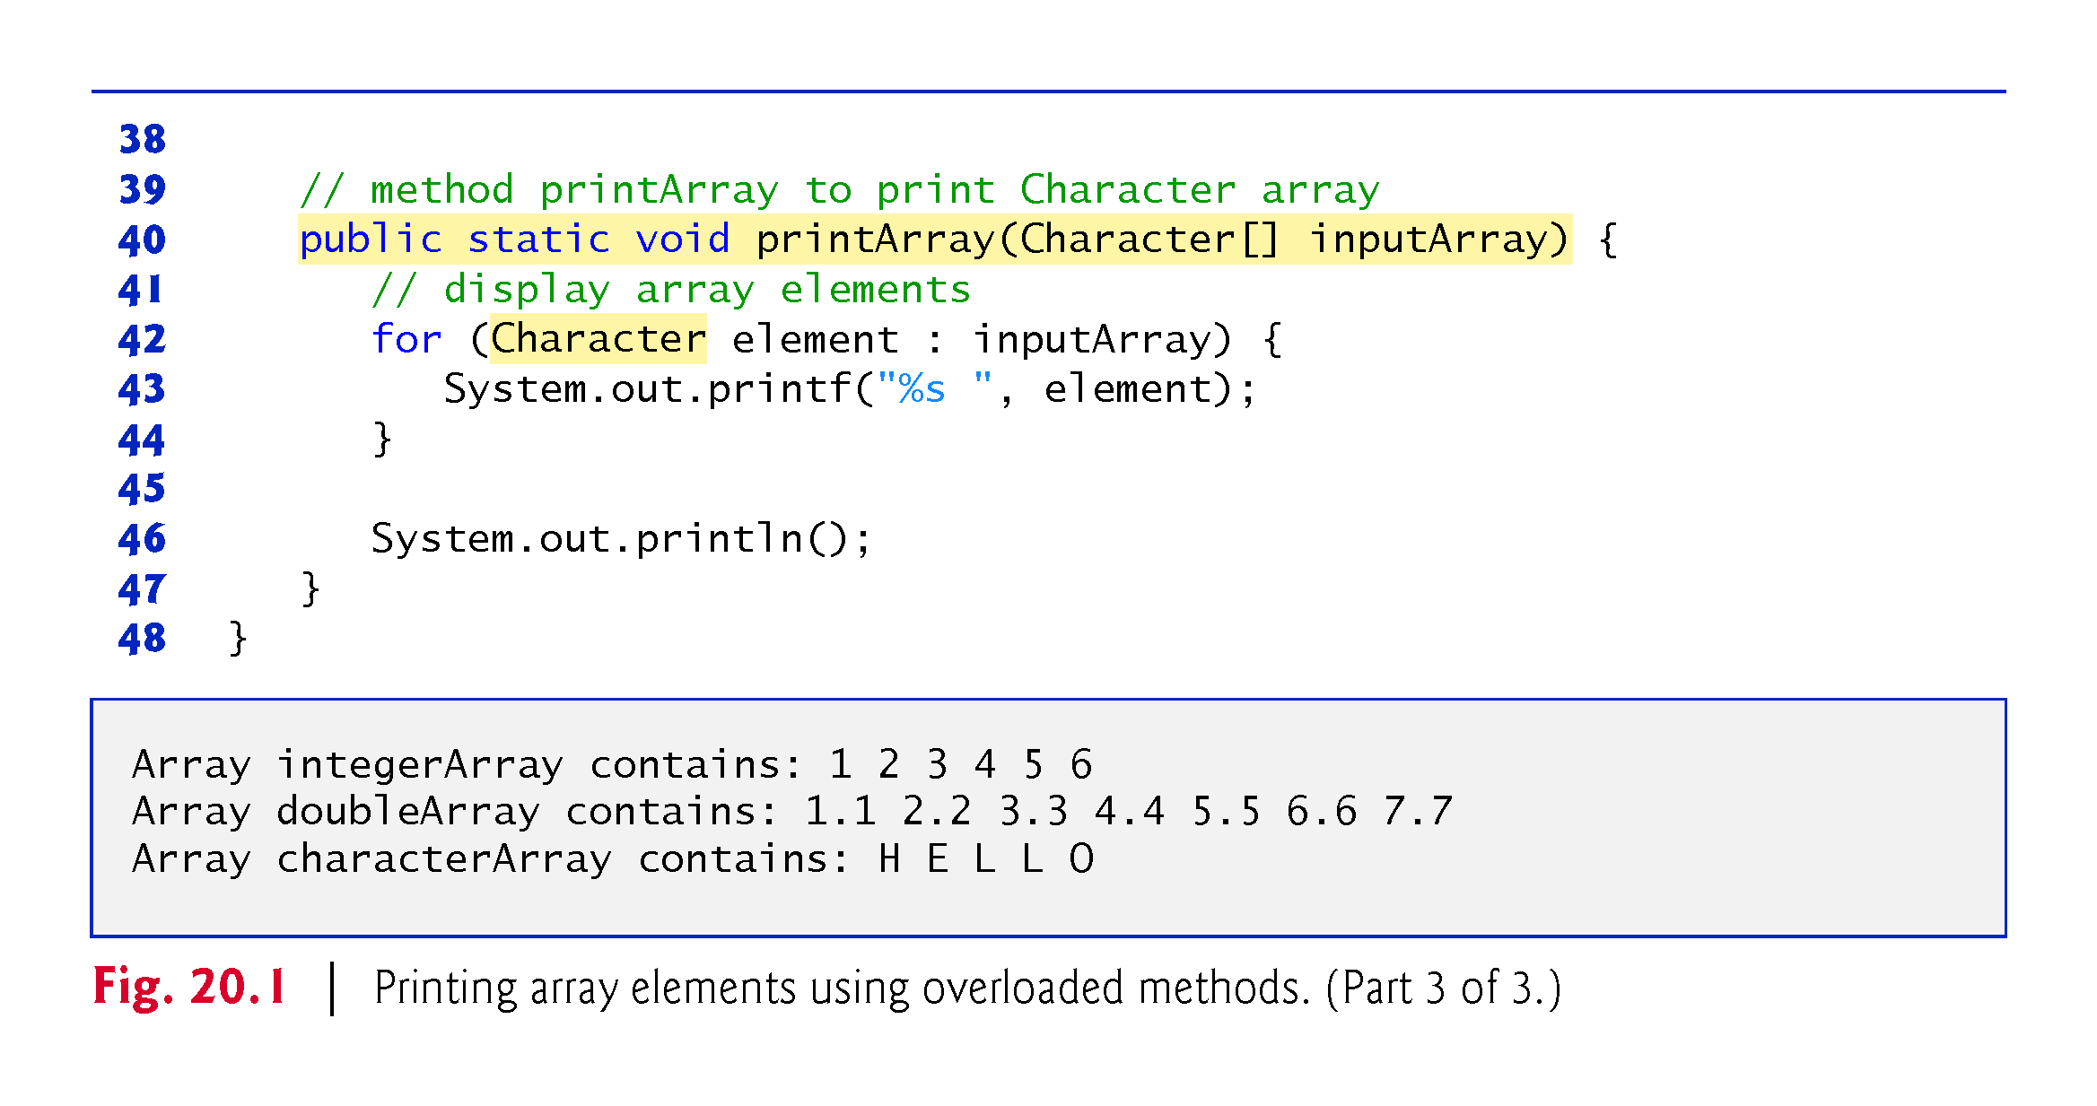

Slide 9
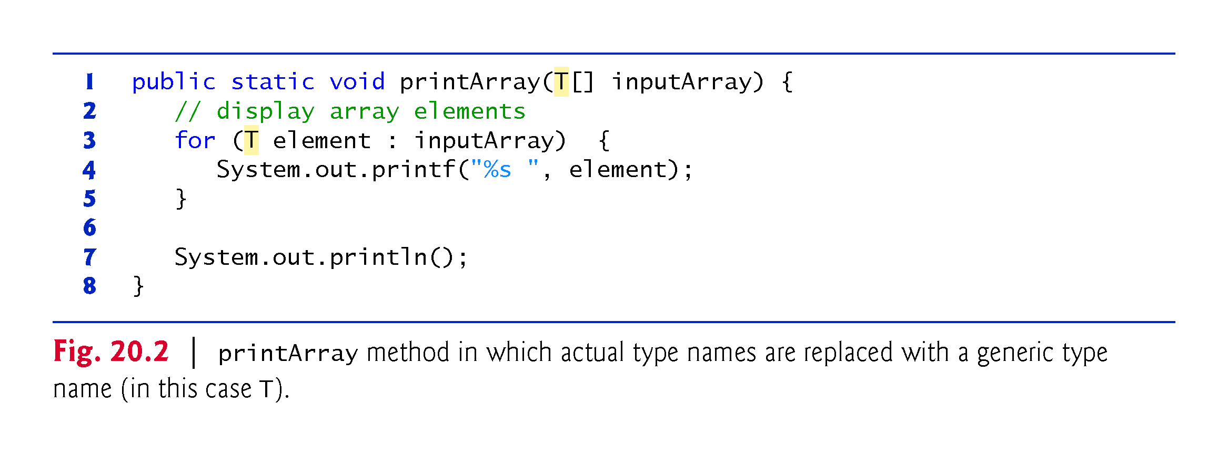

Slide 10
20.3 Generic Methods: Implementation and Compile-Time Translation
If the operations performed by several overloaded methods are identical for each argument type, the overloaded methods can be more conveniently coded using a generic method.
You can write a single generic method declaration that can be called with arguments of different types.
Based on the types of the arguments passed to the generic method, the compiler handles each method call appropriately.

Slide 11
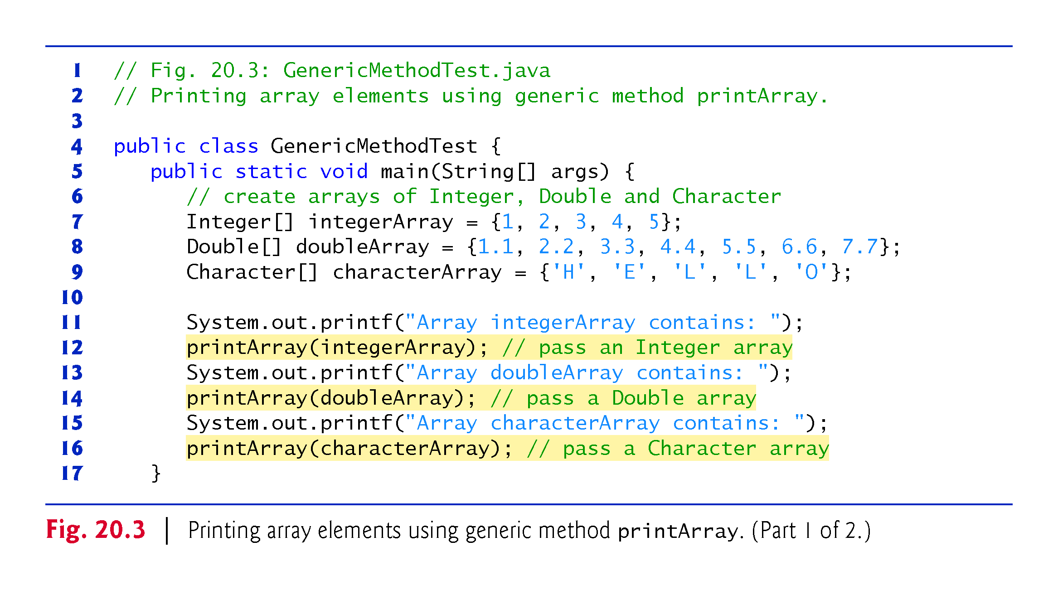

Slide 12
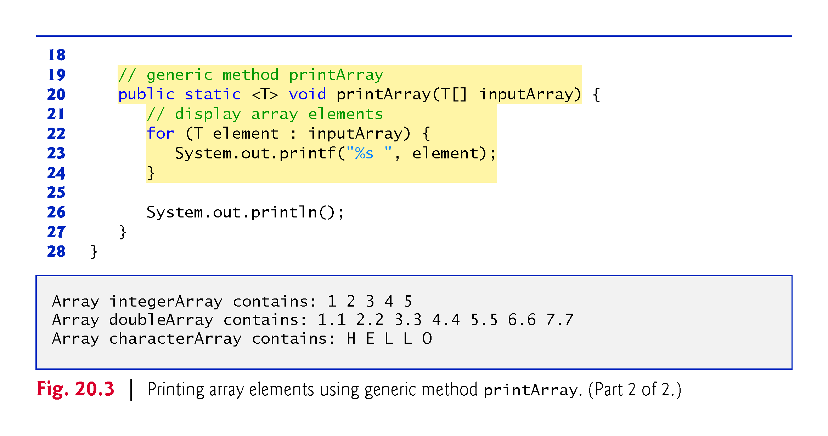

Slide 13
20.3 Generic Methods: Implementation and Compile-Time Translation (cont.)
All generic method declarations have a type-parameter section (< T > in this example) delimited by angle brackets that precedes the method’s return type.
Each type-parameter section contains one or more type parameters, separated by commas.
A type parameter, also known as a type variable, is an identifier that specifies a generic type name.
Can be used to declare the return type, parameter types and local variable types in a generic method, and act as placeholders for the types of the arguments passed to the generic method (actual type arguments).
A generic method’s body is declared like that of any other method.
Type parameters can represent only reference types—not primitive types.

Slide 14
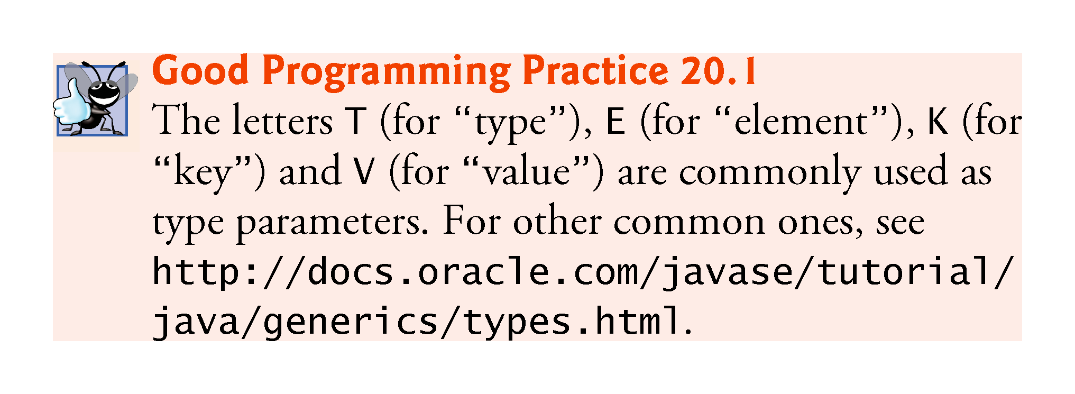

Slide 15
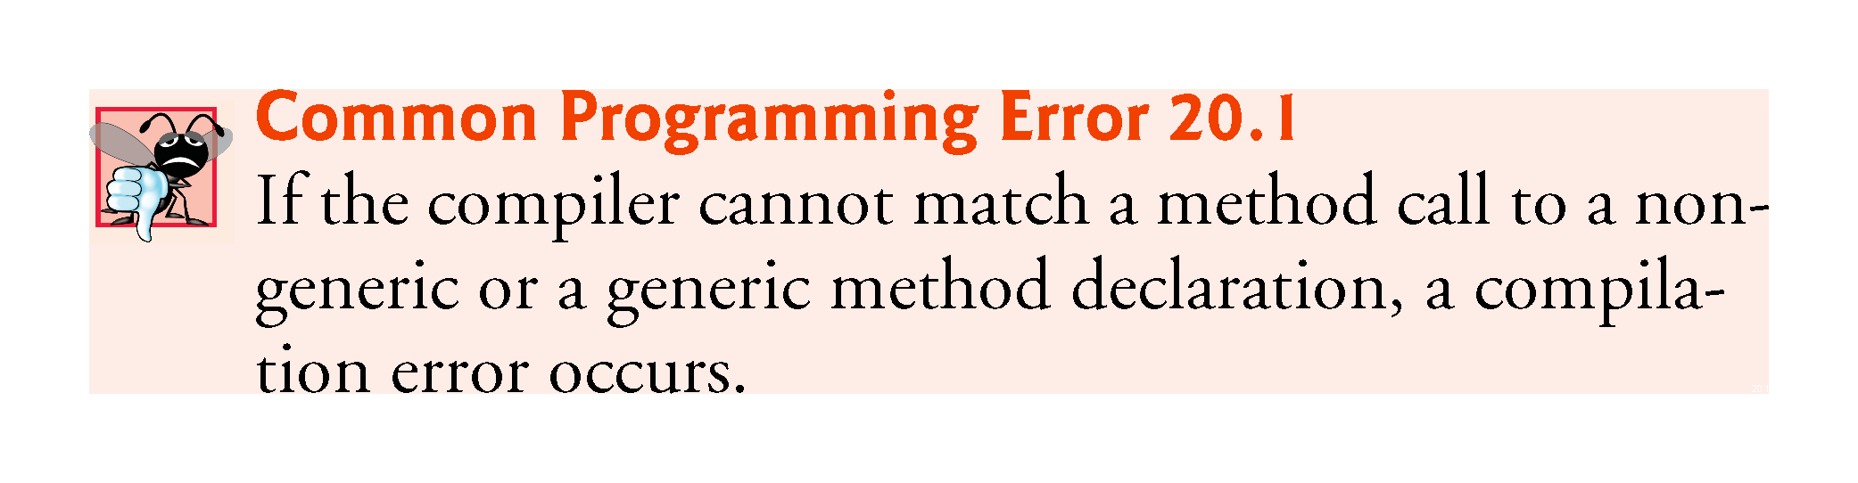

Slide 16
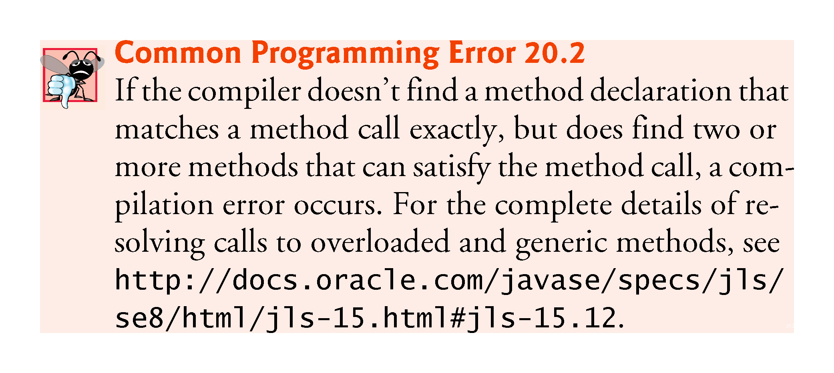

Slide 17
20.3 Generic Methods: Implementation and Compile-Time Translation (cont.)
When the compiler translates generic method printArray into Java bytecodes, it removes the type-parameter section and replaces the type parameters with actual types.
This process is known as erasure.
By default all generic types are replaced with type Object.
So the compiled version of method printArray appears as shown in Fig. 20.4—there is only one copy of this code, which is used for all printArray calls in the example.

Slide 18
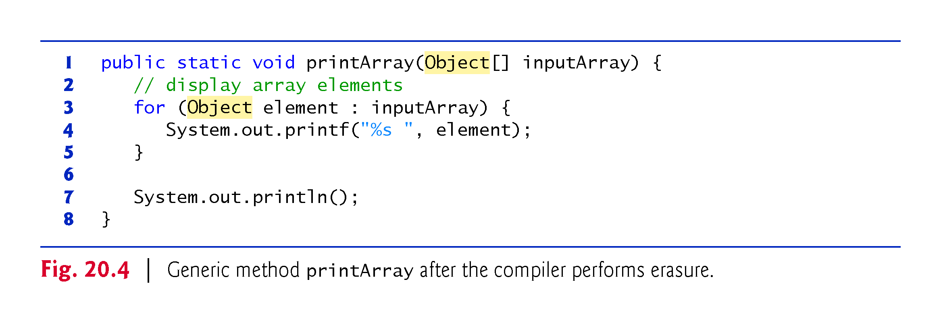

Slide 19
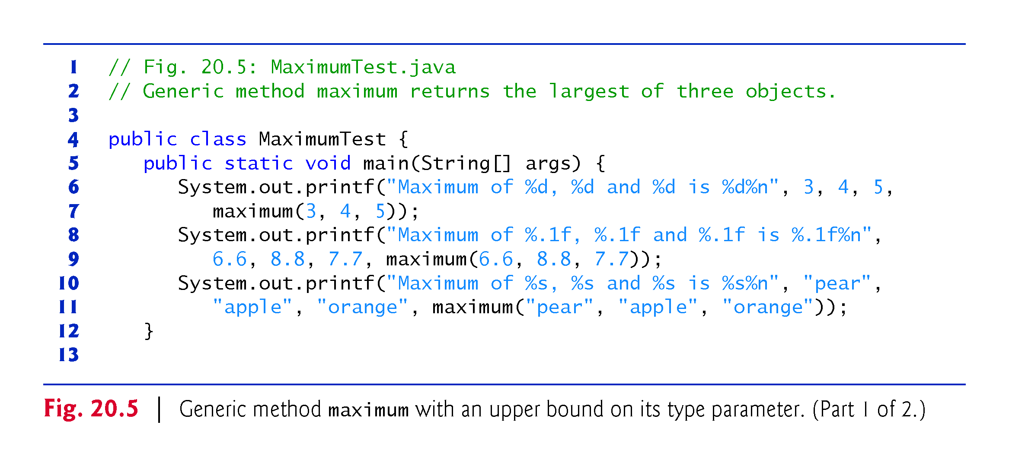

Slide 20
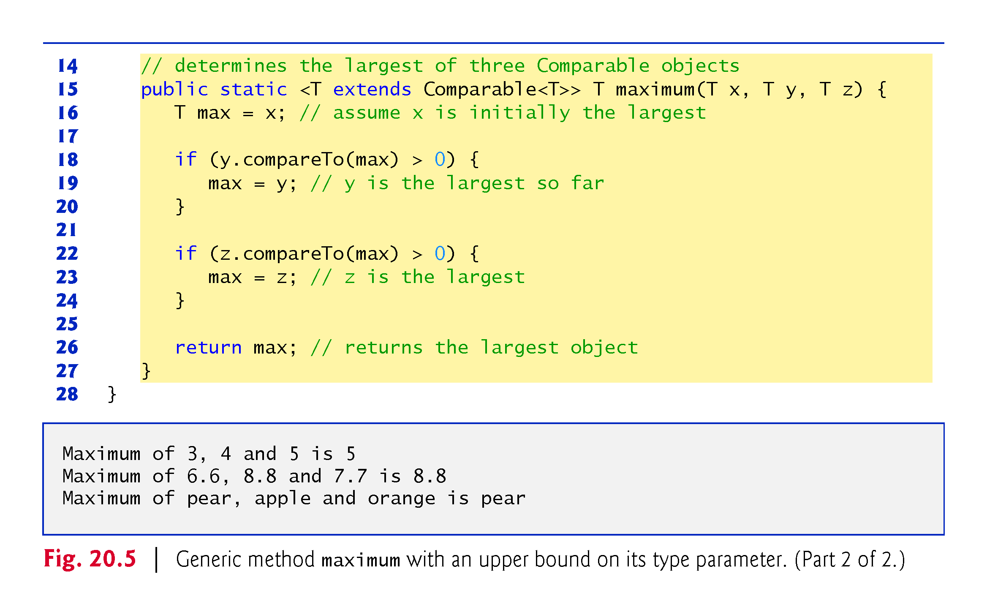

Slide 21
20.4 Additional Compile-Time Translation Issues: Methods That Use a Type Parameter as the Return Type
Generic method maximum determines and returns the largest of its three arguments of the same type.
The relational operator > cannot be used with reference types, but it’s possible to compare two objects of the same class if that class implements the generic interface Comparable<T> (package java.lang).
All the type-wrapper classes for primitive types implement this interface.
Generic interfaces enable you to specify, with a single interface declaration, a set of related types.

Slide 22
20.4 Additional Compile-Time Translation Issues: Methods That Use a Type Parameter as the Return Type (cont.)
Comparable<T> objects have a compareTo method.
The method must return 0 if the objects are equal, a negative integer if object1 is less than object2 or a positive integer if object1 is greater than object2.
A benefit of implementing interface Comparable<T> is that Comparable<T> objects can be used with the sorting and searching methods of class Collections (package java.util).

Slide 23
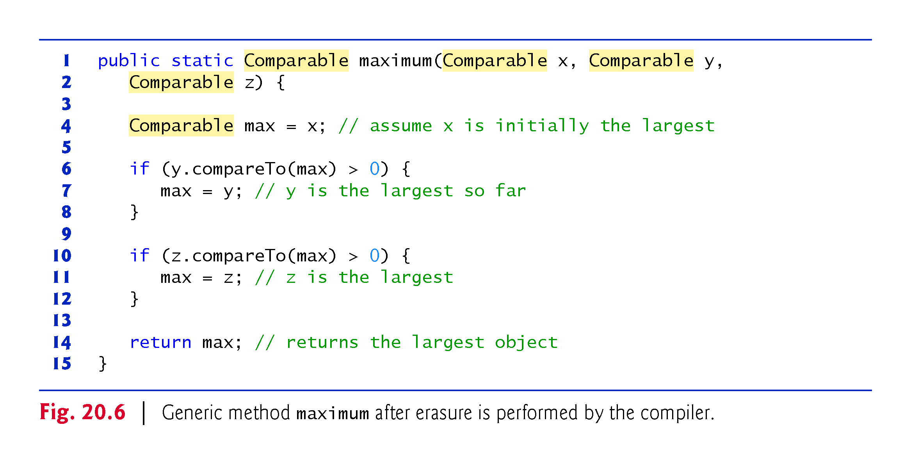

Slide 24
20.5 Overloading Generic Methods
A generic method may be overloaded like any other method.
A class can provide two or more generic methods that specify the same method name but different method parameters.
A generic method can also be overloaded by nongeneric methods.
When the compiler encounters a method call, it searches for the method declaration that best matches the method name and the argument types specified in the call—an error occurs if two or more overloaded methods both could be considered best matches.

Slide 25
20.6 Generic Classes
The concept of a data structure, such as a stack, can be understood independently of the element type it manipulates.
Generic classes provide a means for describing the concept of a stack (or any other class) in a type-independent manner.
These classes are known as parameterized classes or parameterized types because they accept one or more type parameters.

Slide 26
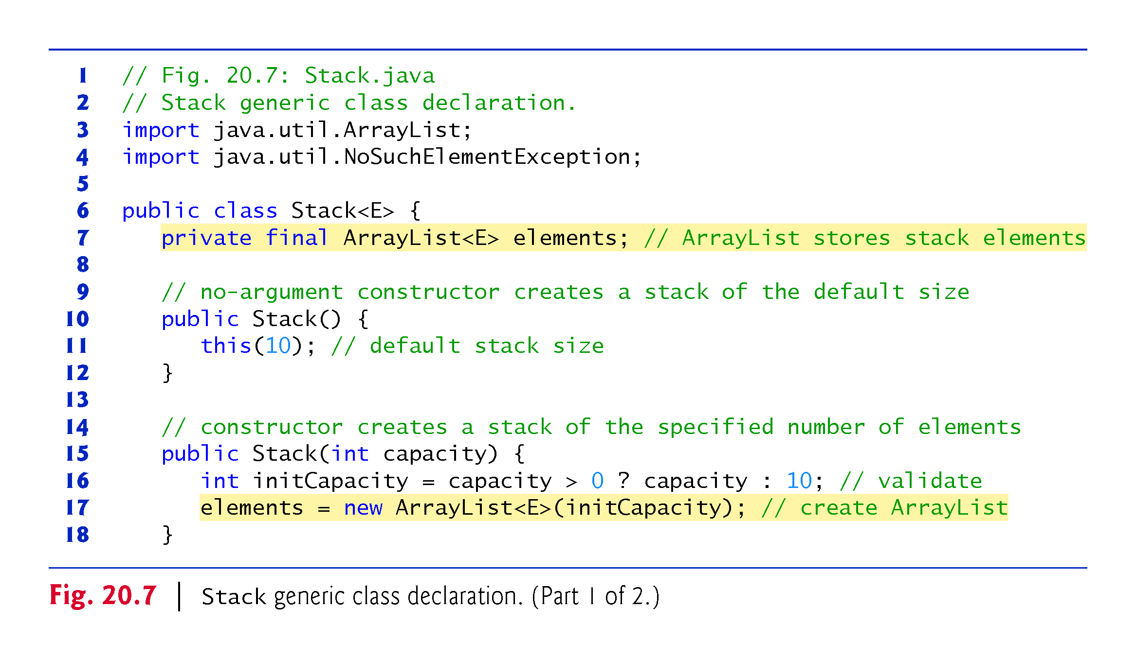

Slide 27
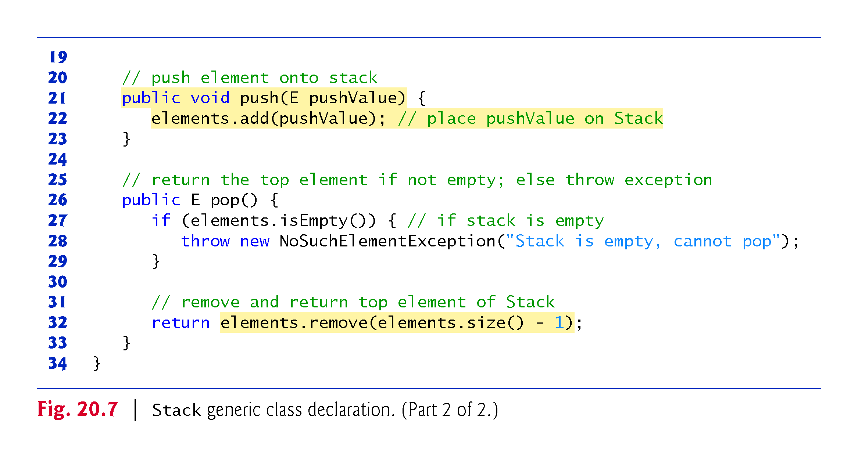

Slide 28
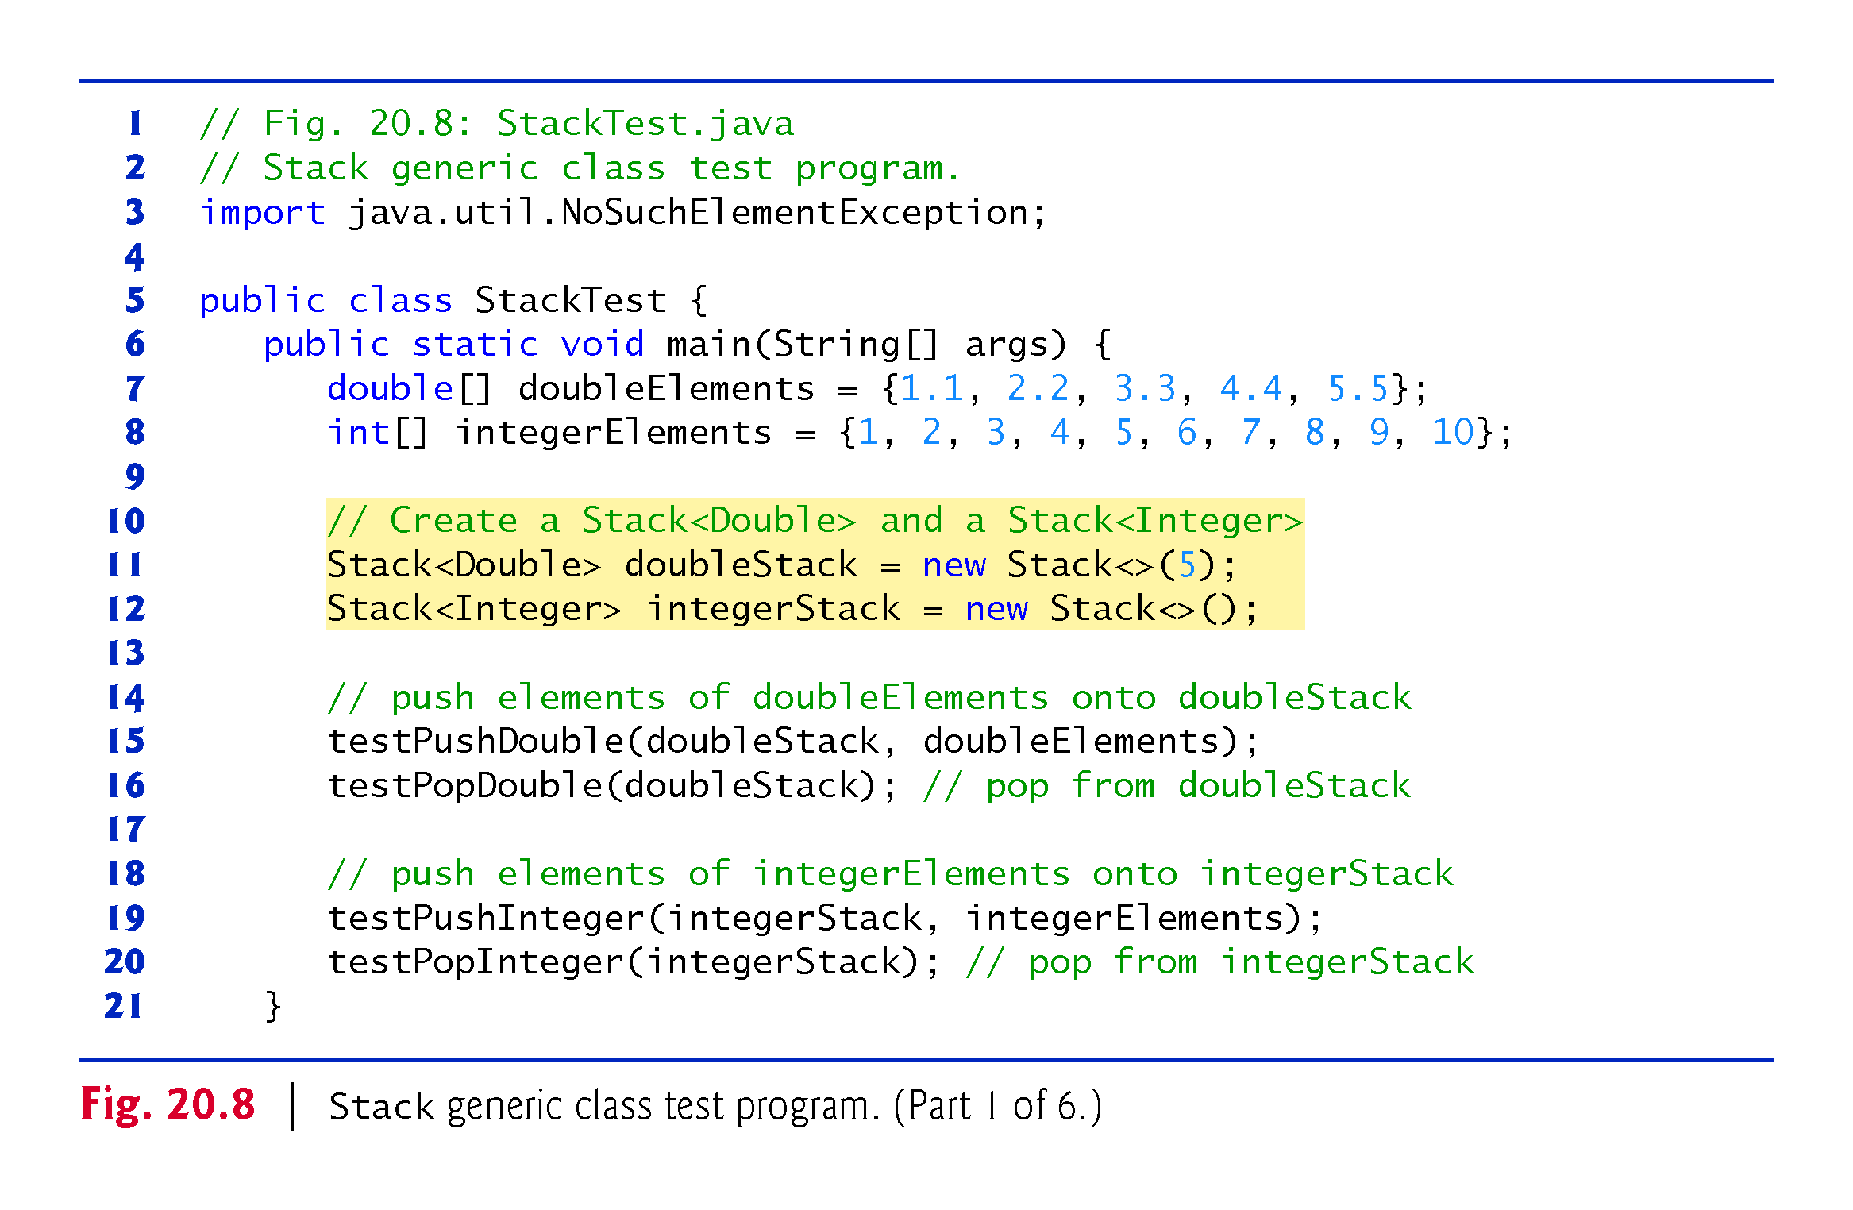

Slide 29
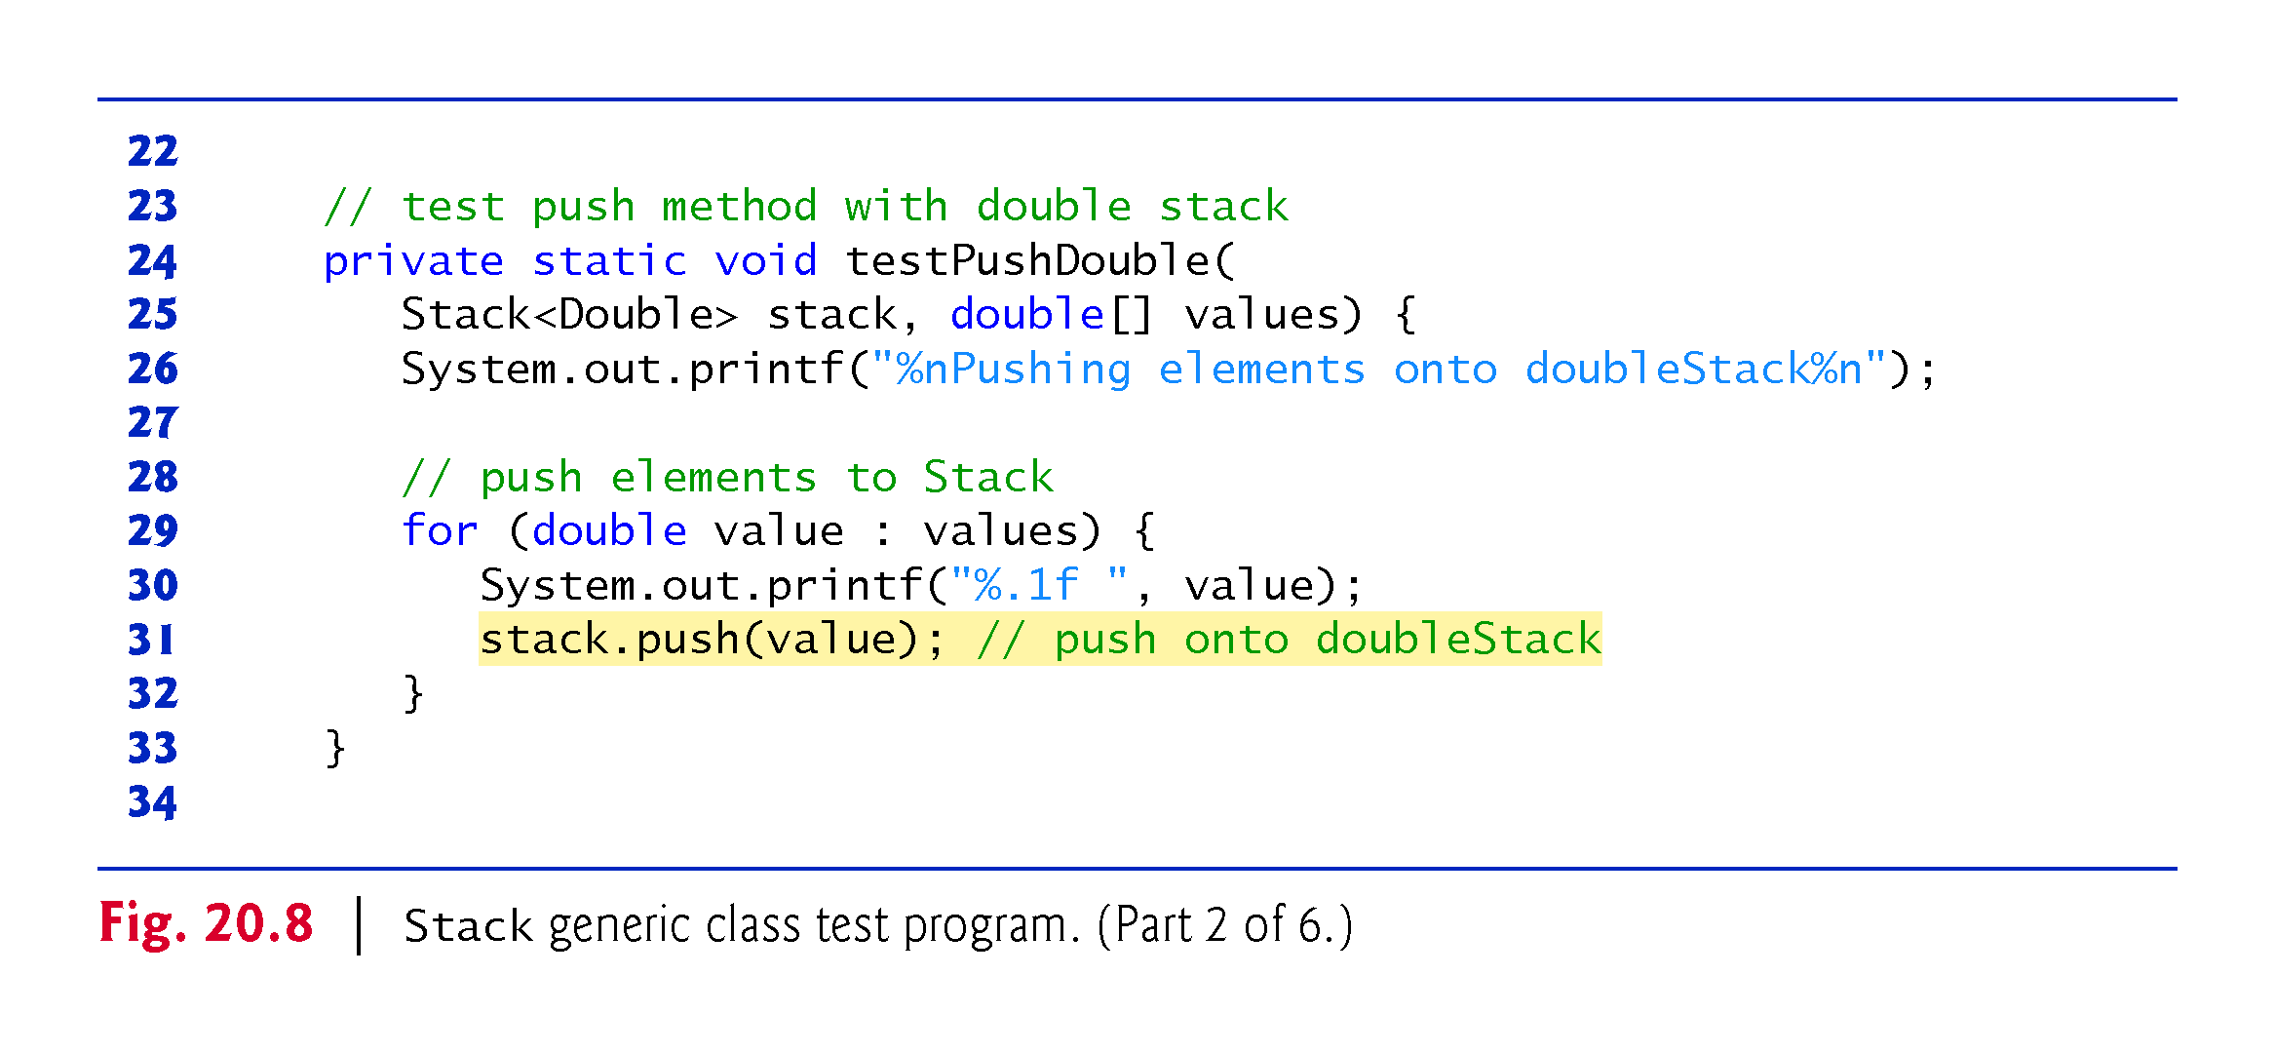

Slide 30
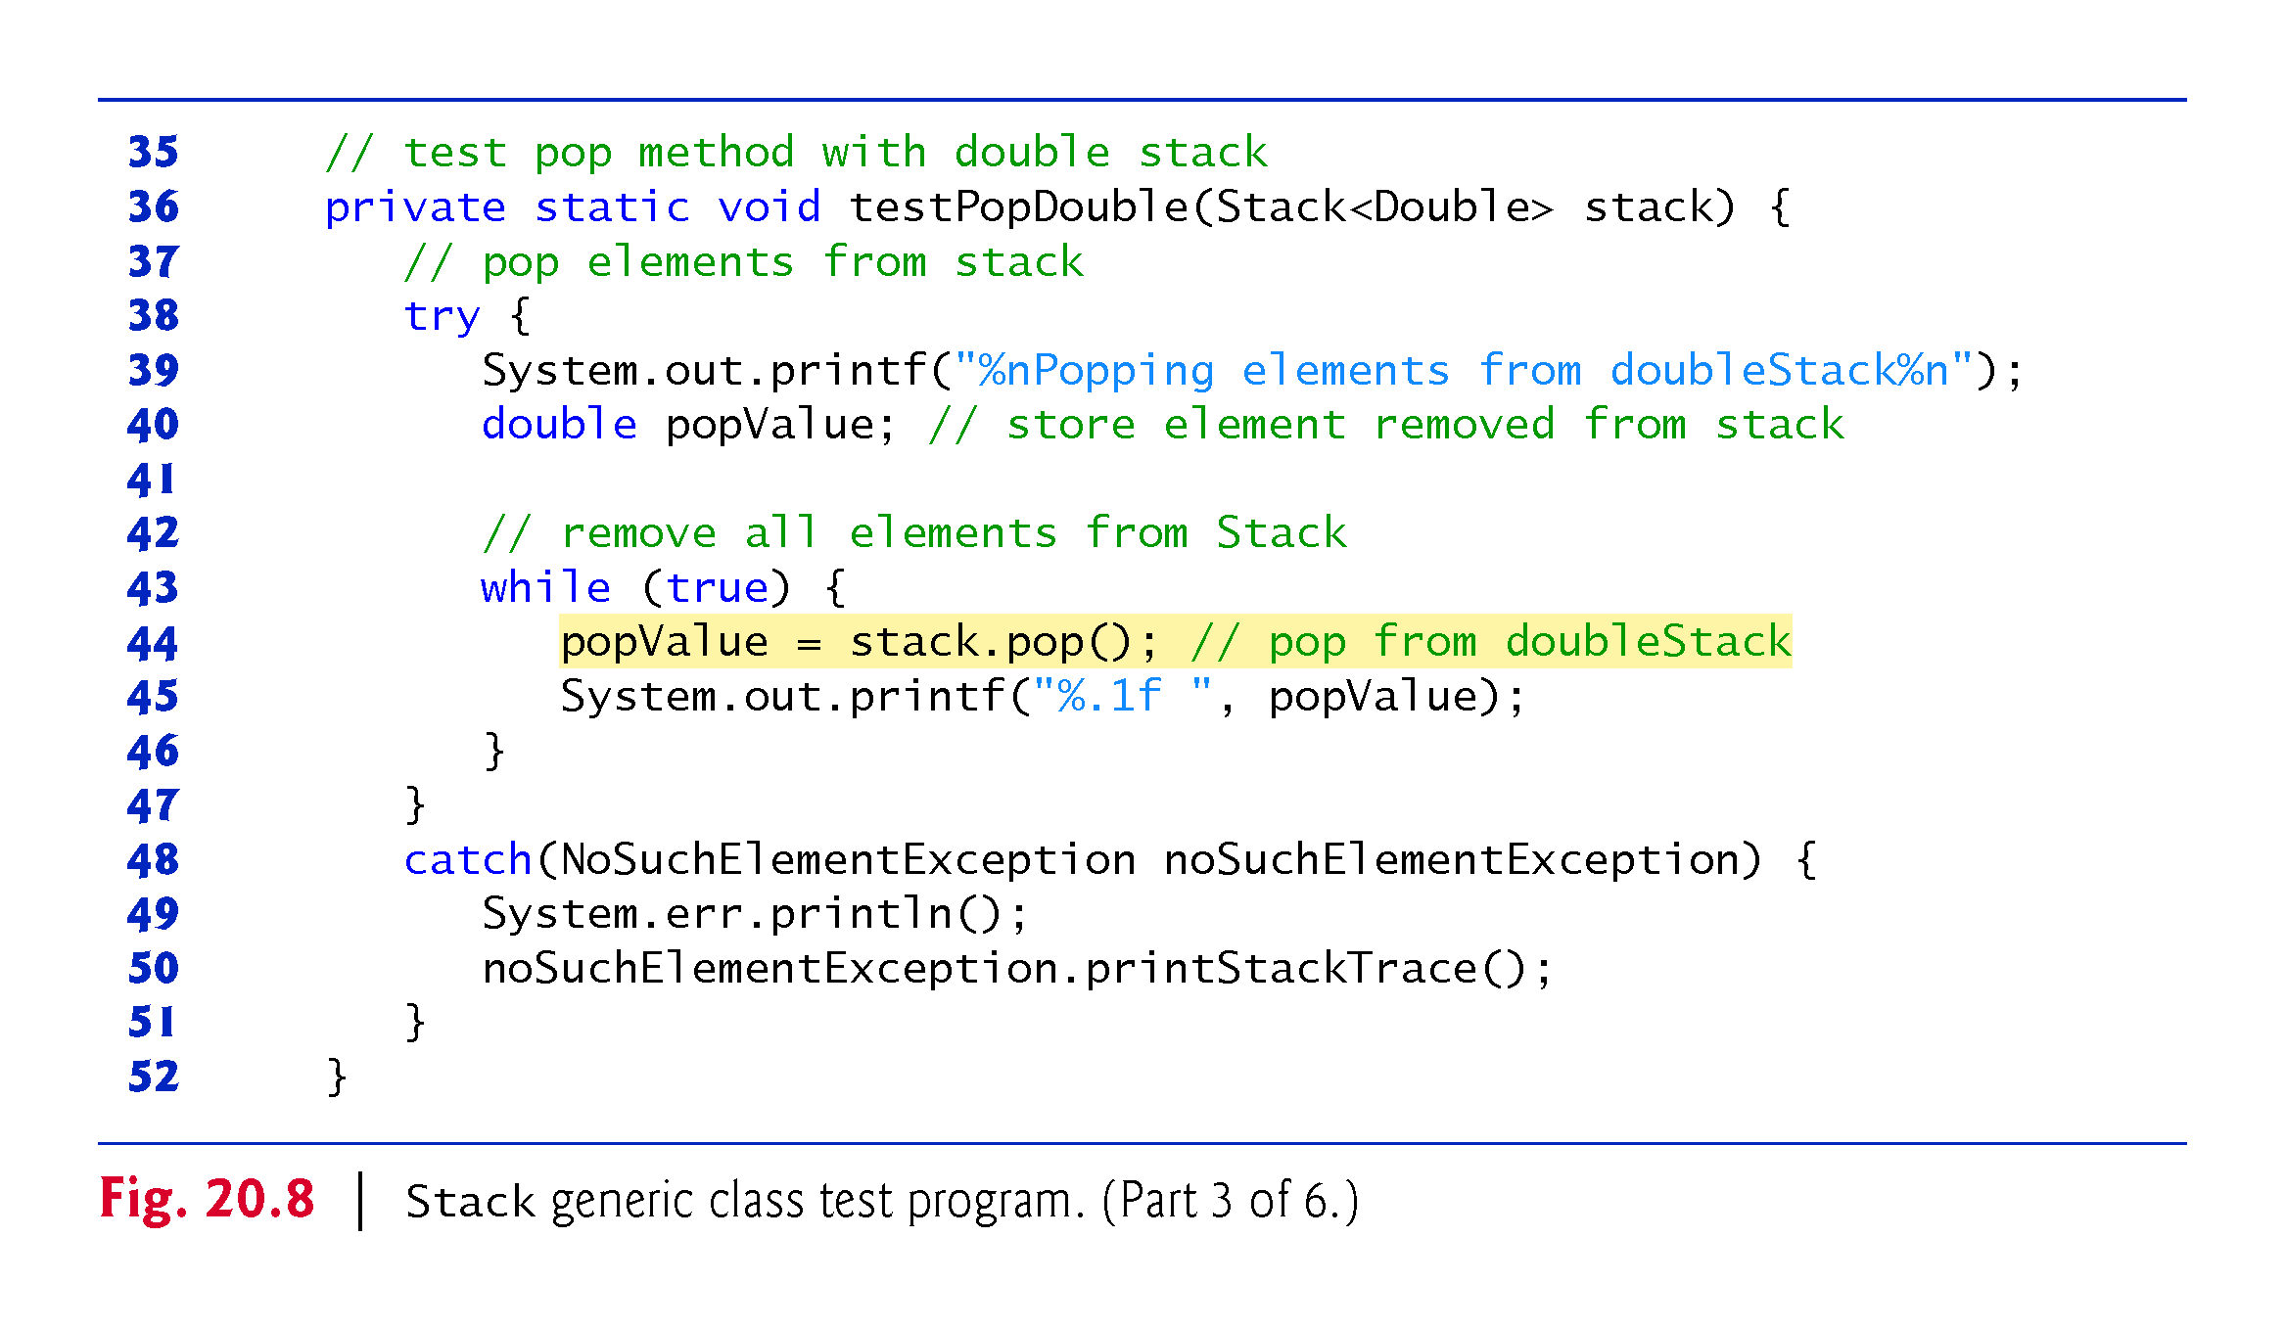

Slide 31


Slide 32
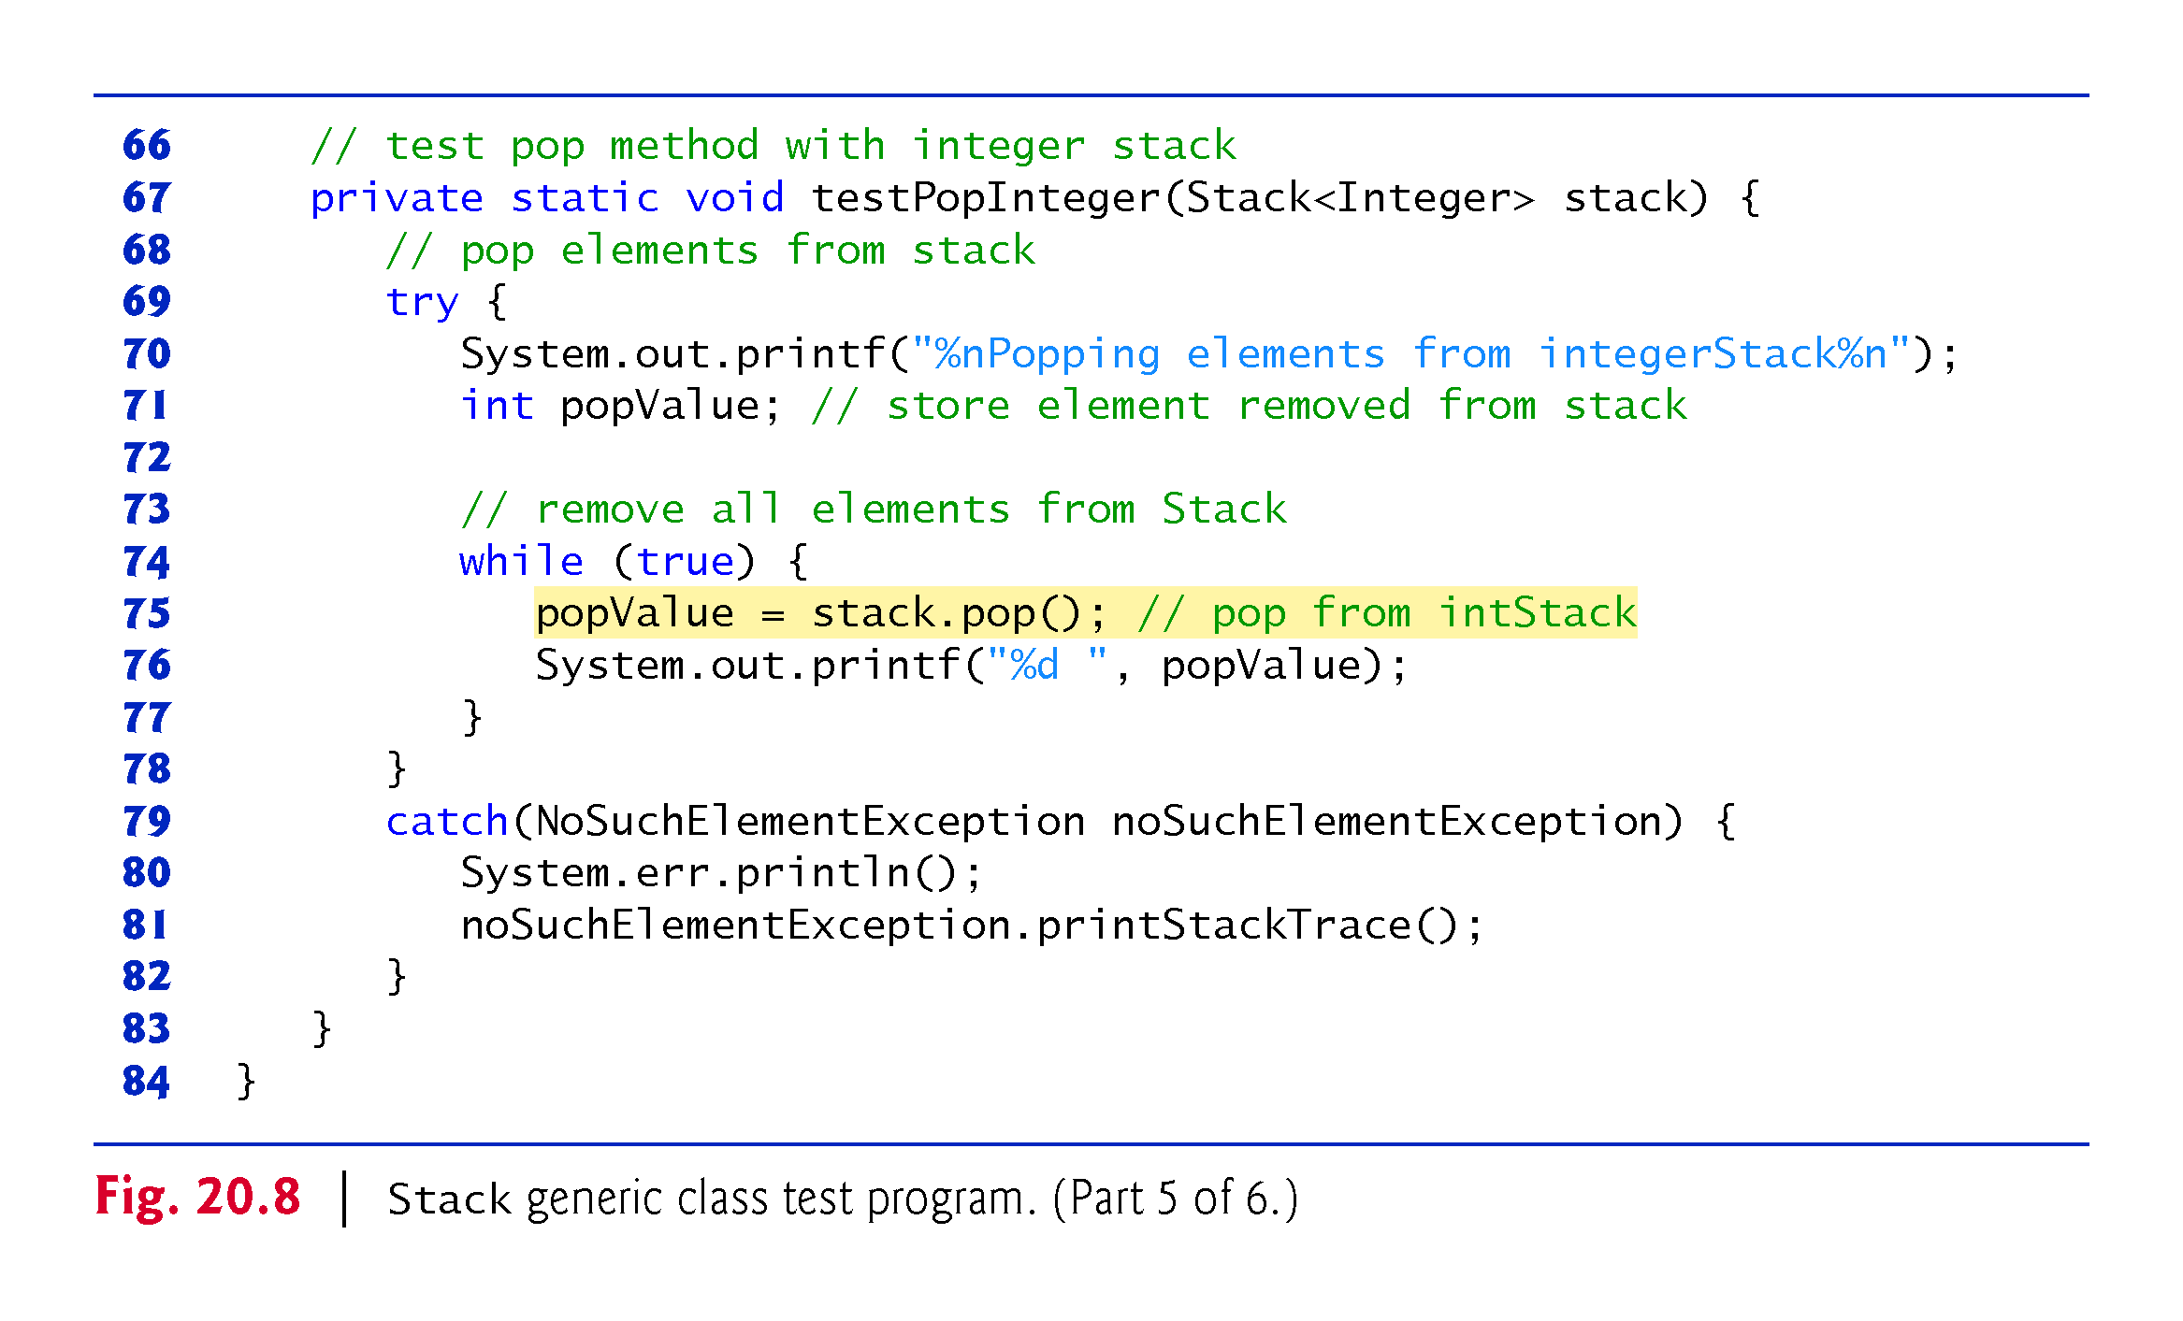

Slide 33
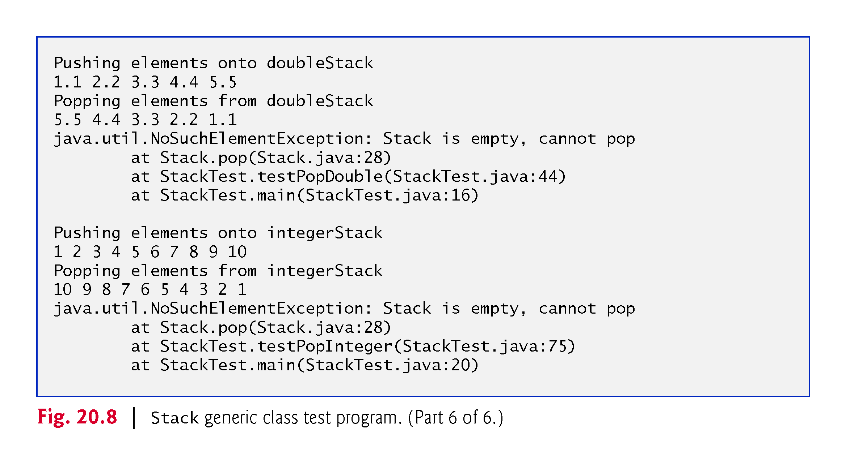

Slide 34
20.6 Generic Classes (cont.)
The code in methods testPushDouble and testPushInteger from the previous example is almost identical for pushing values onto a Stack<Double> or a Stack<Integer>, respectively, and the code in methods testPopDouble and testPopInteger is almost identical for popping values from a Stack<Double> or a Stack<Integer>, respectively.
This presents another opportunity to use generic methods.

Slide 35
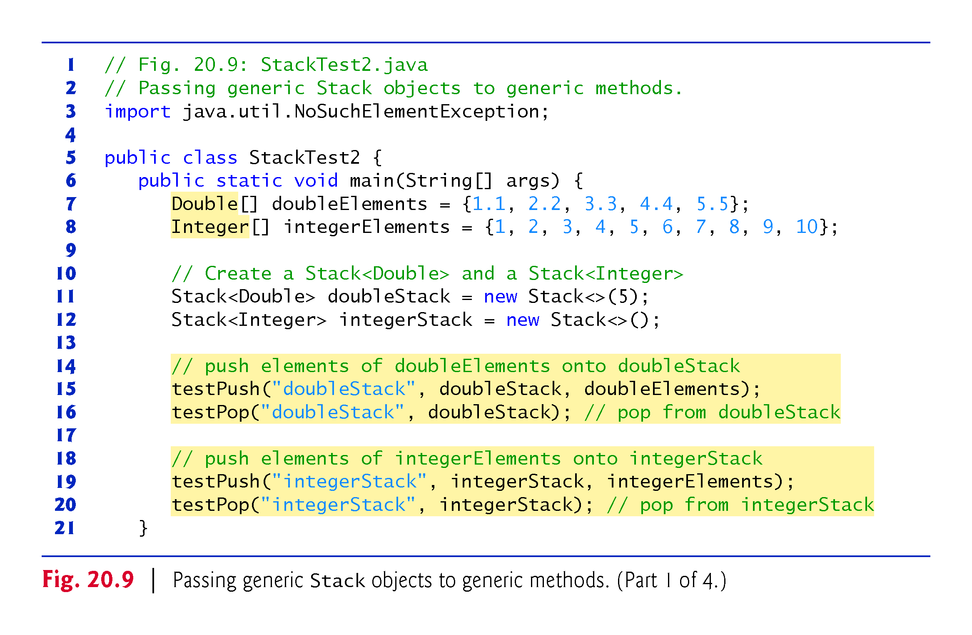

Slide 36
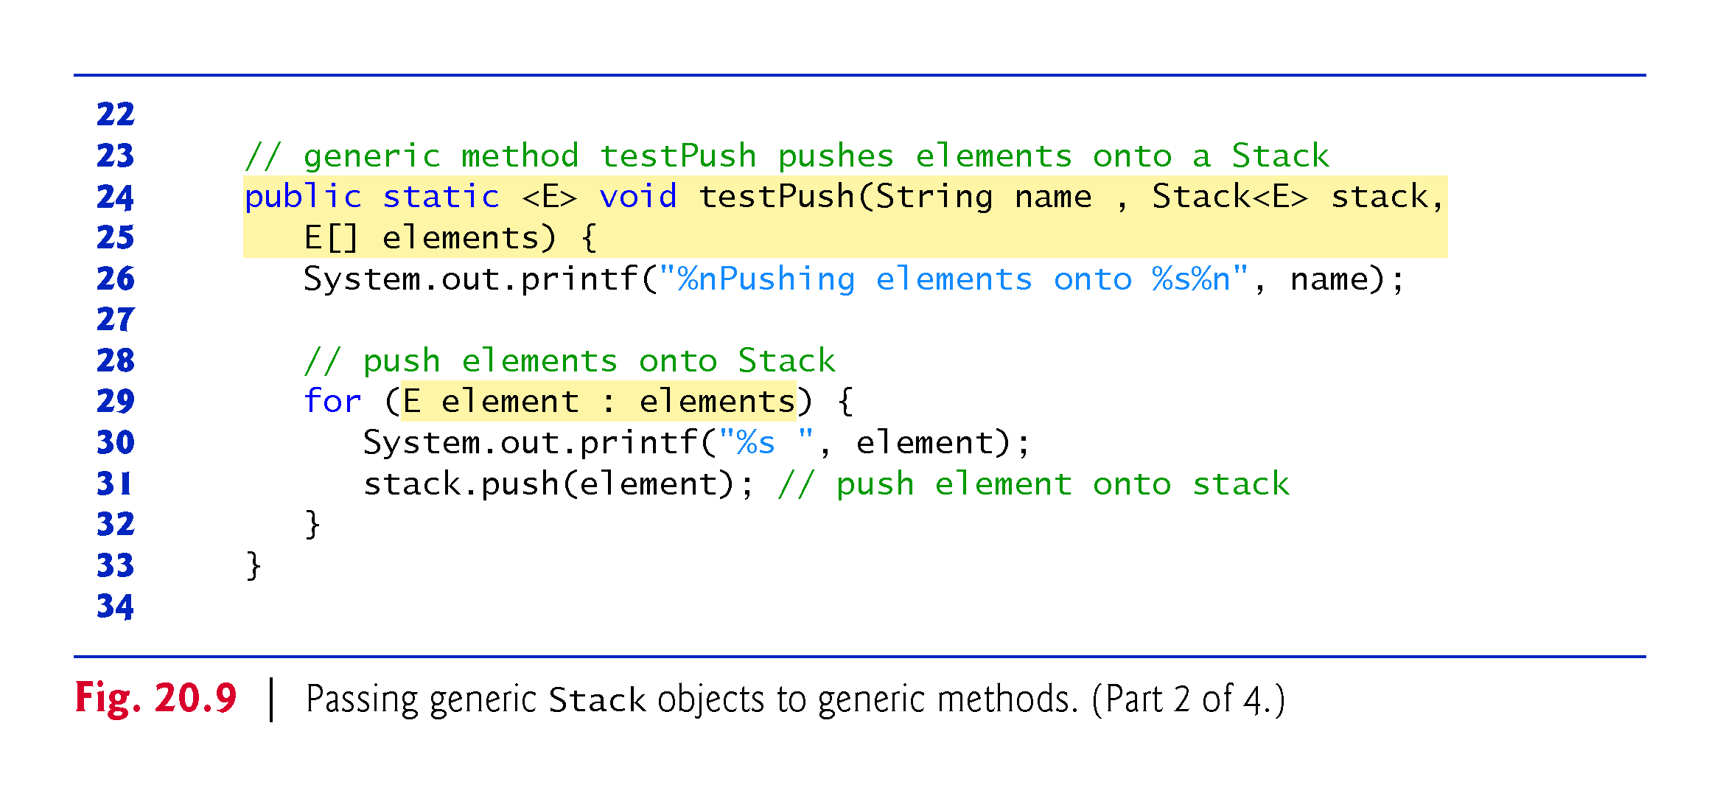

Slide 37
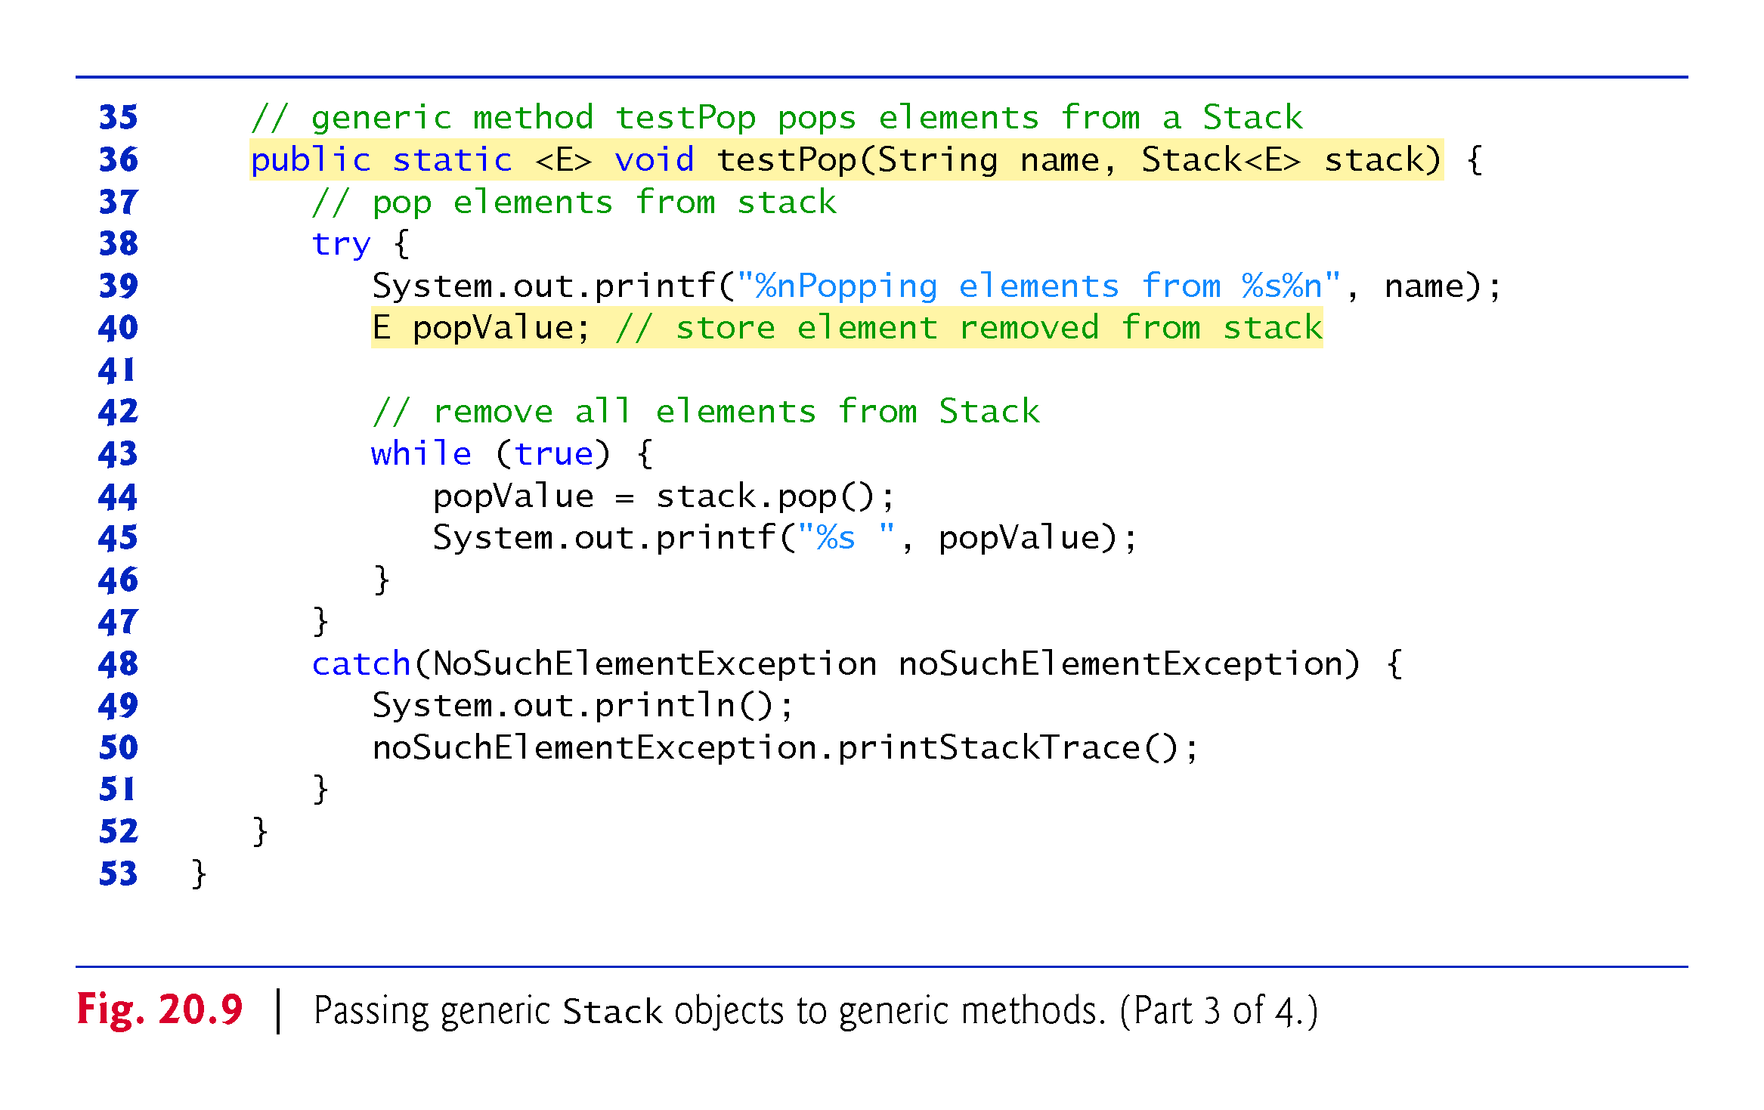

Slide 38
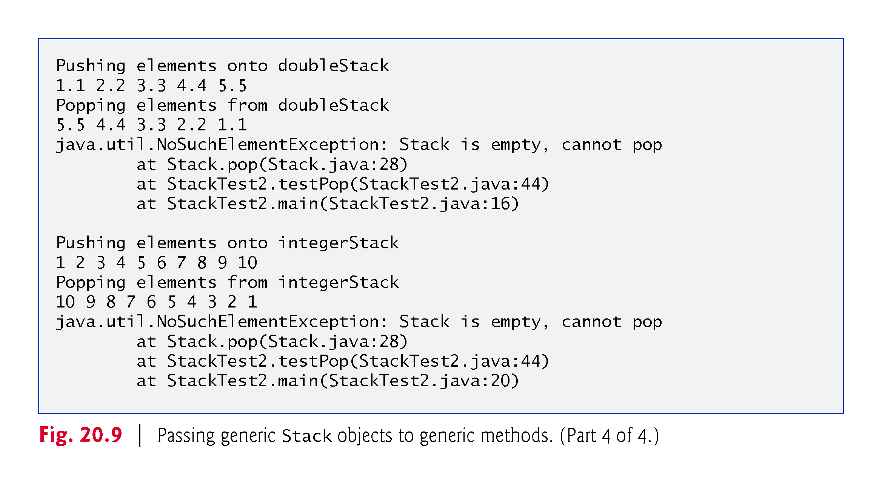

Slide 39
20.7 Wildcards in Methods That Accept Type Parameters
In this section, we introduce a powerful generics concept known as wildcards.
Suppose that you’d like to implement a generic method sum that totals the numbers in a List.
You’d begin by inserting the numbers in the collection.
The numbers would be autoboxed as objects of the type-wrapper classes—any int value would be autoboxed as an Integer object, and any double value would be autoboxed as a Double object.
We’d like to be able to total all the numbers in the List regardless of their type.
For this reason, we’ll declare the List with the type argument Number, which is the superclass of both Integer and Double.
In addition, method sum will receive a parameter of type List <Number> and total its elements.

Slide 40
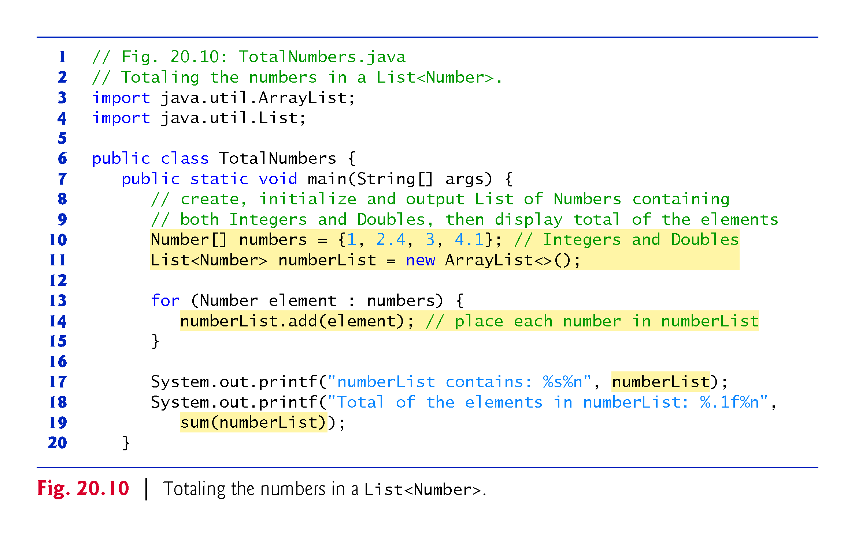

Slide 41
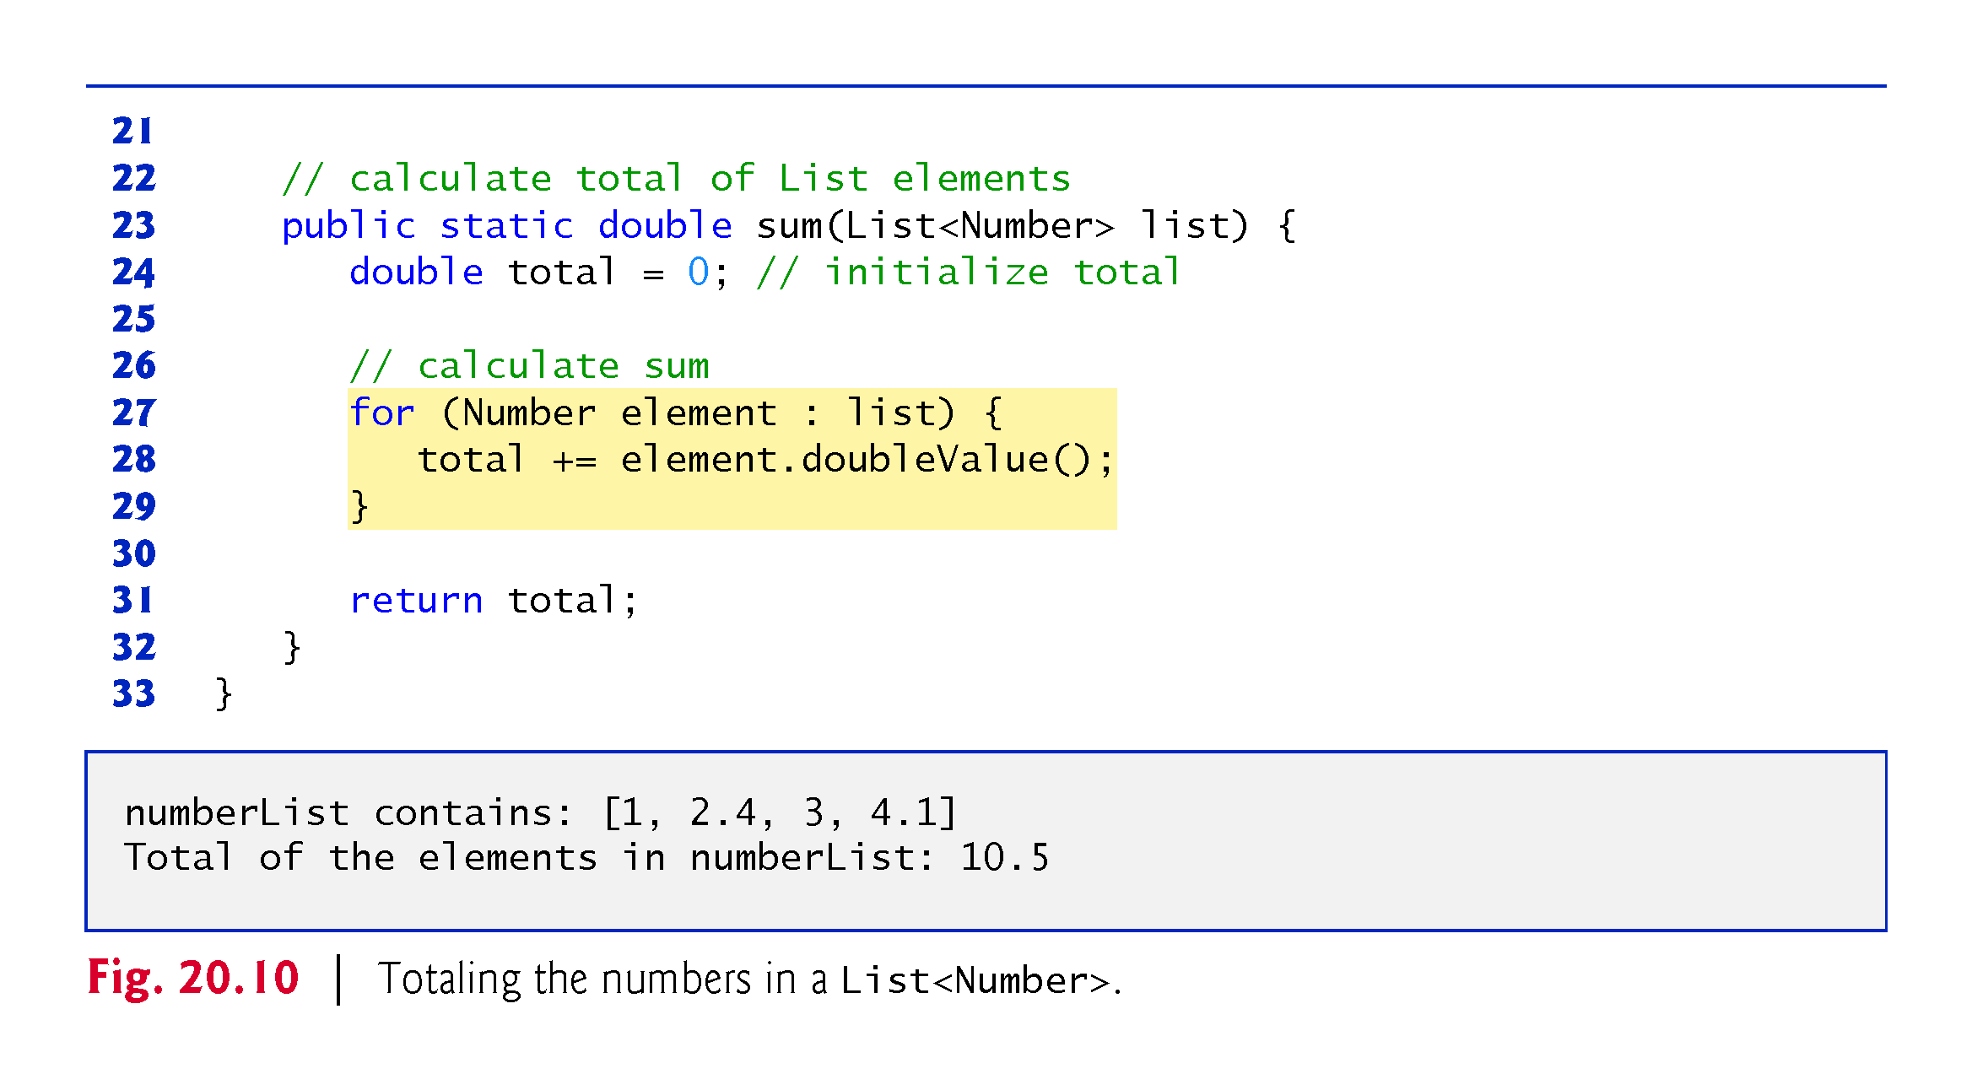

Slide 42
20.7 Wildcards in Methods That Accept Type Parameters (cont.)
In method sum:
The for statement assigns each Number in the List to variable element, then uses Number method doubleValue to obtain the Number’s underlying primitive value as a double value.
The result is added to total.
When the loop terminates, the method returns the total.

Slide 43
20.7 Wildcards in Methods That Accept Type Parameters (cont.)
Given that method sum can total the elements of a List of Numbers, you might expect that the method would also work for Lists that contain elements of only one numeric type, such as List<Integer>.
Modified class TotalNumbers to create an List of Integers and pass it to method sum.
When we compile the program, the compiler issues the following error message:
sum(java.util.List<java.lang.Number>) in TotalNumbersErrors cannot be applied to (java.util.List<java.lang.Integer>)
Although Number is the superclass of Integer, the compiler doesn’t consider the parameterized type List<Number> to be a superclass of List<Integer>.
If it were, then every operation we could perform on List<Number> would also work on an List<Integer>.

Slide 44
20.7 Wildcards in Methods That Accept Type Parameters (cont.)
To create a more flexible version of the sum method that can total the elements of any List containing elements of any subclass of Number we use wildcard-type arguments.
Wildcards enable you to specify method parameters, return values, variables or fields, and so on, that act as supertypes or subtypes of parameterized types.
In Fig. 20.11, method sum’s parameter is declared with the type:
List<? extends Number>
A wildcard-type argument is denoted by a question mark (?), which by itself represents an “unknown type.”
In this case, the wildcard extends class Number, which means that the wildcard has an upper bound of Number.
Thus, the unknown-type argument must be either Number or a subclass of Number.

Slide 45
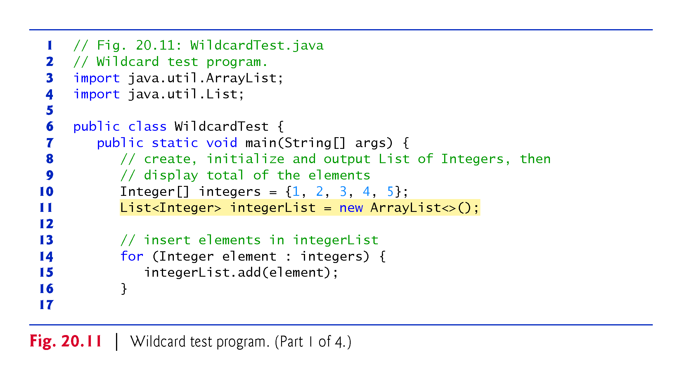

Slide 46
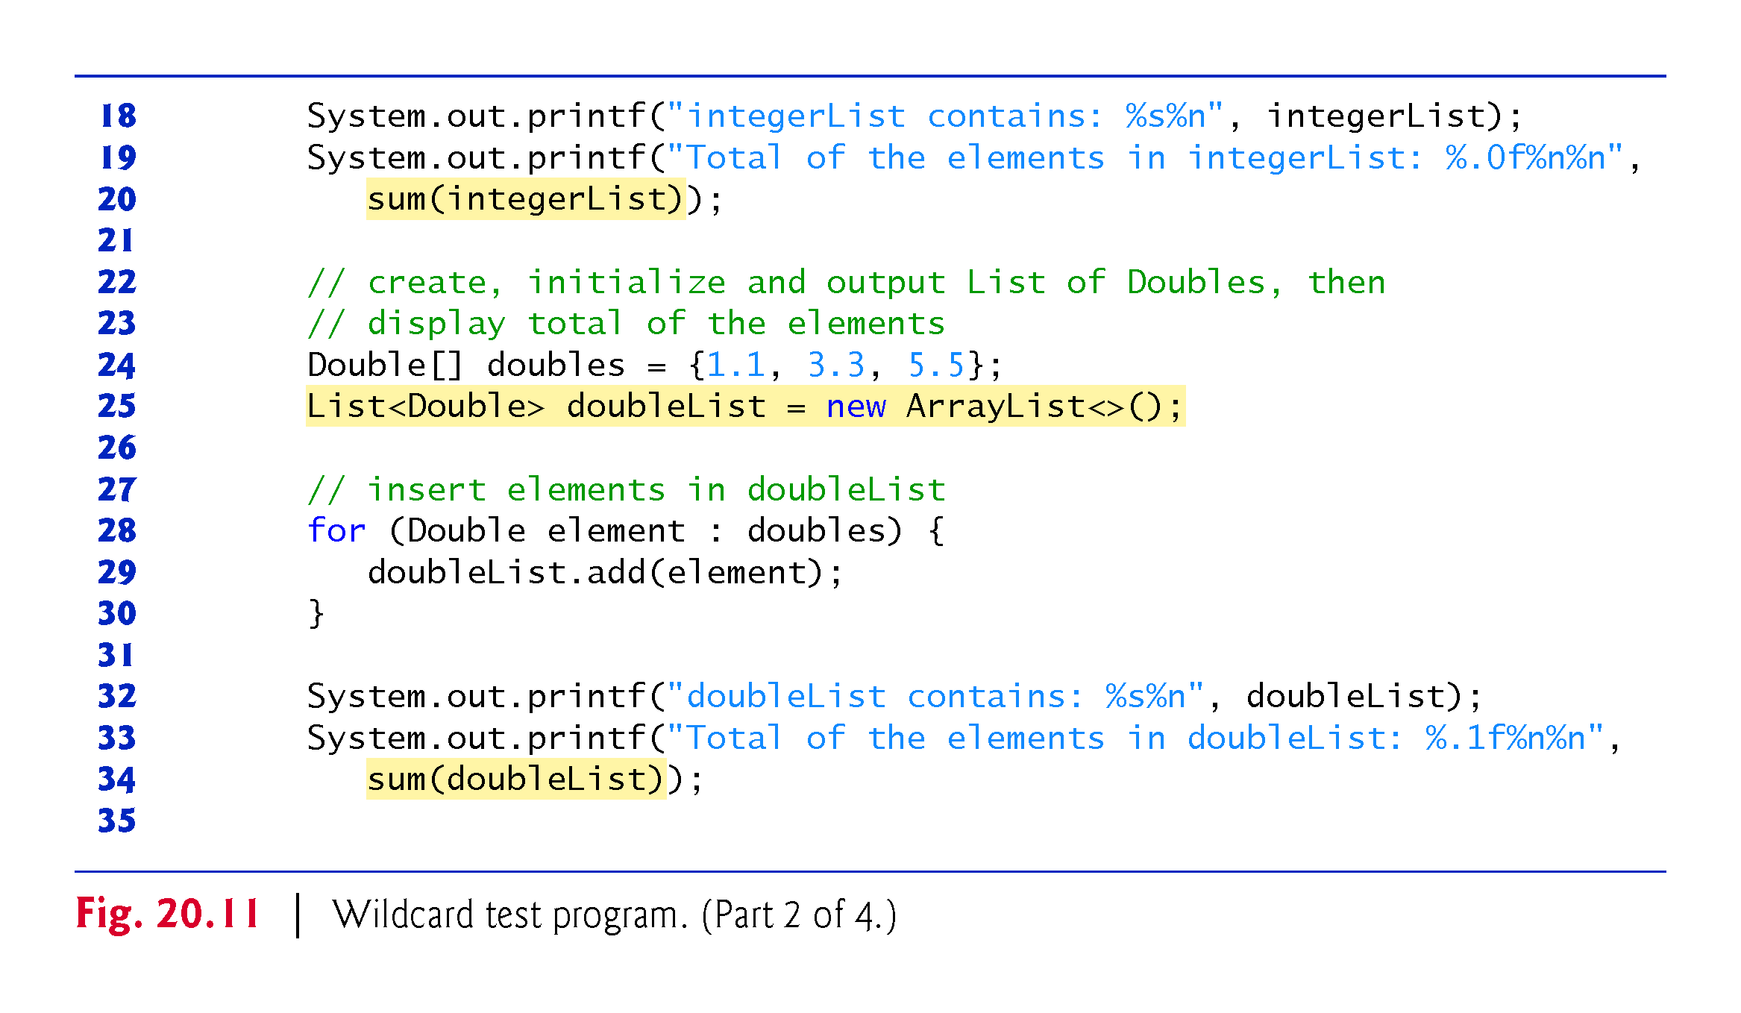

Slide 47
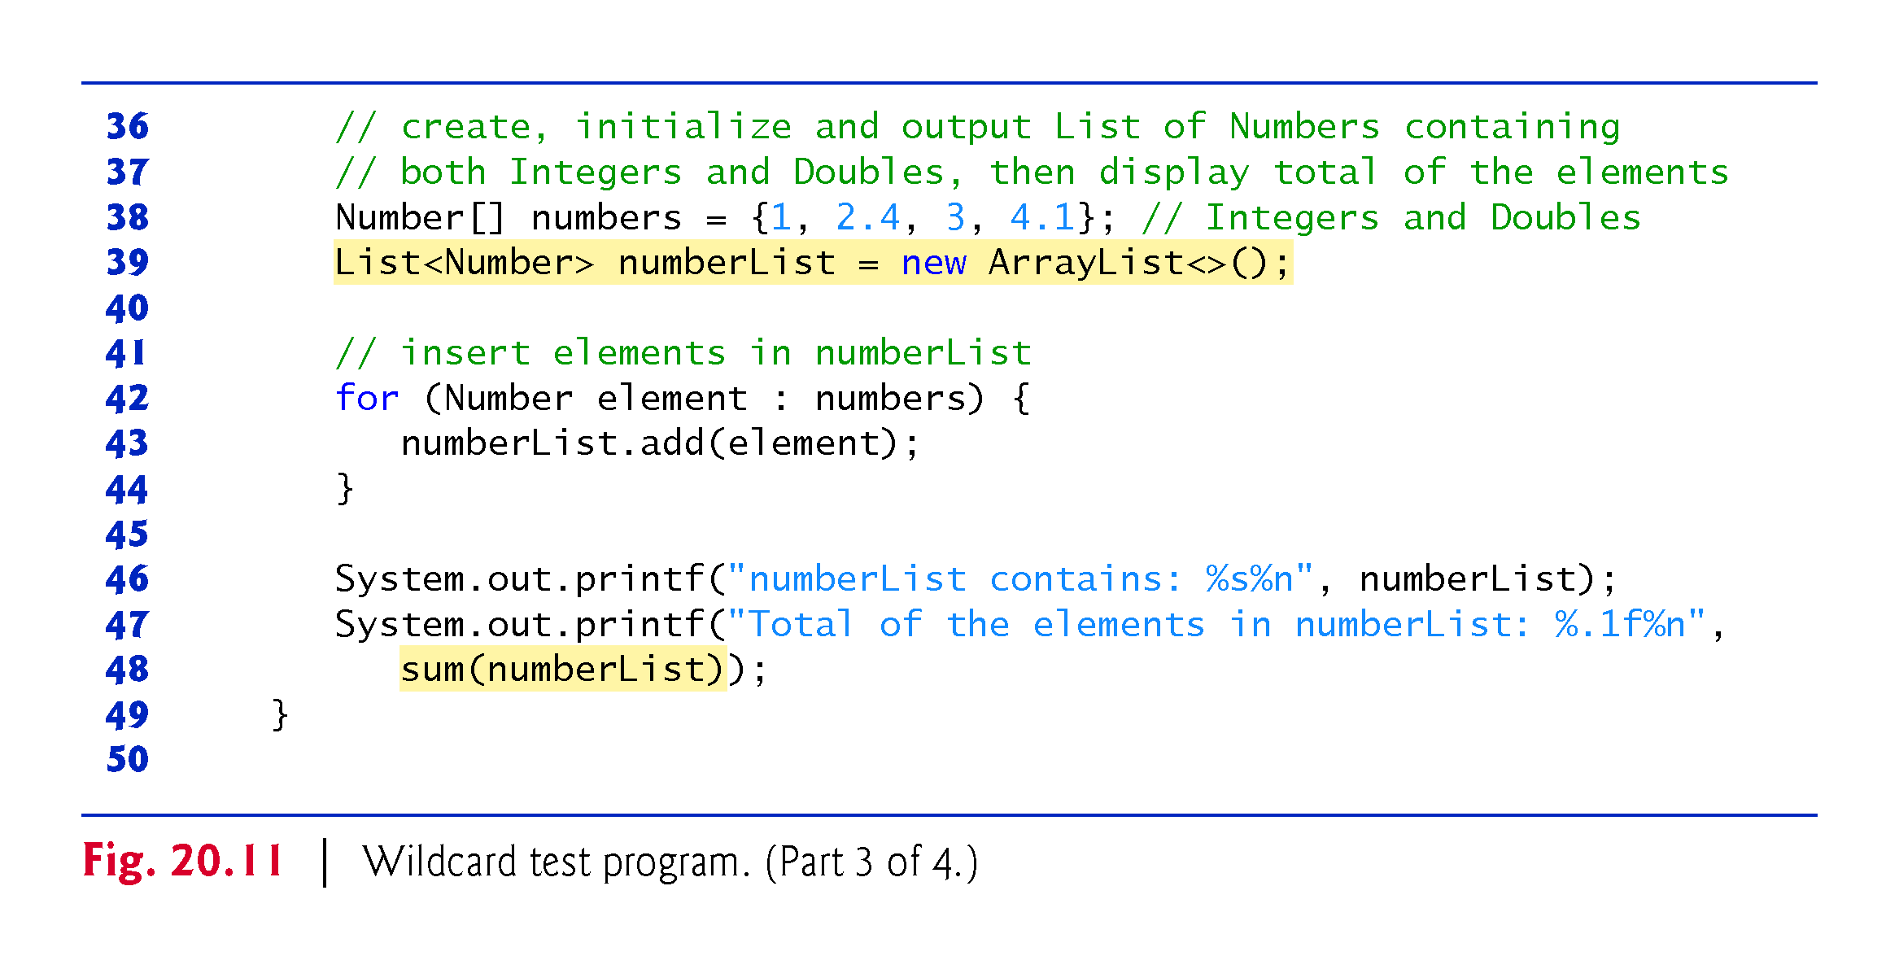

Slide 48
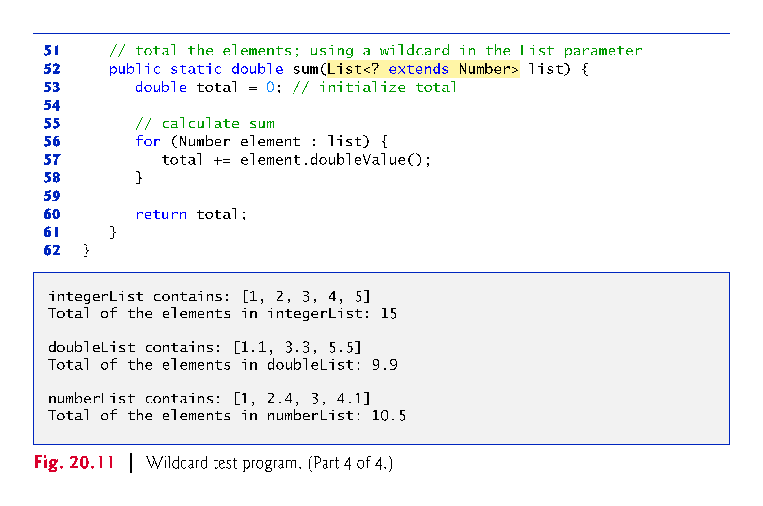

Slide 49
20.7 Wildcards in Methods That Accept Type Parameters (cont.)
Because the wildcard (?) in the method’s header does not specify a type-parameter name, you cannot use it as a type name throughout the method’s body
You could, however, declare method sum as follows:
public static <T extends Number> double sum(List<T> list)
Allows the method to receive an List that contains elements of any Number subclass.
You could then use the type parameter T throughout the method body.
If the wildcard is specified without an upper bound, then only the methods of type Object can be invoked on values of the wildcard type.
Also, methods that use wildcards in their parameter’s type arguments cannot be used to add elements to a collection referenced by the parameter.

Slide 50
